Slide 1
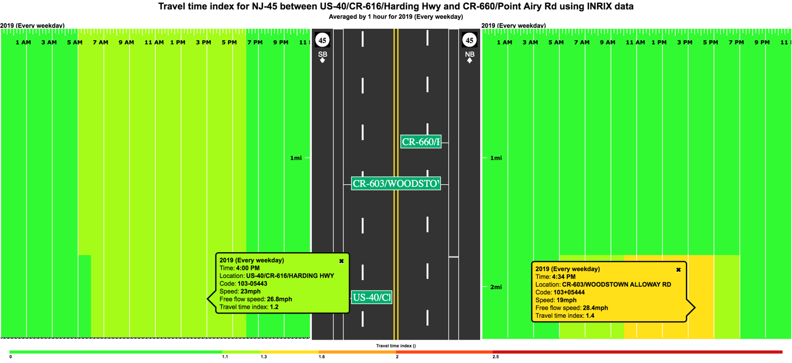
NJ 45 (MP 9.44 – 10.44)
Salem County
PDA Suite* Congestion Scan Analysis
PDA TTI Scan for weekdays of year 2019
Assessment for Average Travel Time on this section (Averaged by 1 hour):
Travel Time Indices (TTIs) of 1.4 were recorded within this section of NJ 45 Northbound during the PM period. This indicates that travel within this section generally takes 1.4 times longer than travel under uncongested conditions indicating that this section is Mildly Congested at that time.
Travel Time Indices (TTIs) of 1.2 were recorded within this section of NJ 45 Southbound during the PM period indicating that this section is Mildly Congested at that time.
* Probe Data Analytics (PDA) Suite is developed by the University of Maryland for the I-95 Corridor Coalition.

