Slide 1
Notes:
Make a copy of this google slide file to work on and save. This is a template - You can add a new slide by going to “slide” and then “apply layout”.

Slide 2
MISSION:
To empower nonprofits and social enterprises to transform their leadership and management and advance our vision for social change.
VISION: Our vision for social change is tied to the envisioned outcomes for our work. Specifically, we envision a society where: ● Coalitions and organizations have the resources needed to understand and address inequities. ● Boards and their organizations work towards identifying, retaining, and advancing more diverse leadership. ● Communities and the people most directly impacted lead and represent organizations and coalitions. ● Support Center, our partners, and clients hold each other and themselves accountable to understanding the systems that perpetuate inequities across health, wealth, happiness, safety, and security. ● We design and adopt new ways of operating that question the practices of a white dominant culture.
ACCELERATING POSITIVE SOCIAL CHANGE

Slide 3
WHAT WE DO
STRATEGY AND MANAGEMENT
Through effective planning and strategy development, we can help your organization maximize the opportunities and minimize the negative effects that come with change. Our change experts and organizational tools provide a breadth of services so nonprofits can improve their effectiveness to achieve long-term goals.
PROFESSIONAL AND LEADERSHIP DEVELOPMENT
We provide tools and strategies to empower nonprofit leaders and staff and increase their effectiveness and bring together organizations and funders to share learning and drive innovative, cutting-edge thinking in the sector.
EXECUTIVE TRANSITION
We cover the full leadership transition process, while helping organizations maintain their strengths and values, minimize risk, and solidify their standing with all stakeholders. Our interim leadership approach enables organizations to keep running their programs and services at full capacity while undergoing the search for a new leader.
ORGANIZATIONAL NAVIGATION
We support long-term change in organizations using an “organizational coaching” approach to help organizations over 12- and 24-month periods in navigating shifts in their operating environment or phases in their growth. Our goal is to enable organizations to become agents of their own capacity building.

Slide 4
In brief, the strategic priorities to facilitate positive social change include the following:
Partnerships: Developing and growing partnerships that advance our vision for social change.
Talent: Expanding opportunities for more representative and diverse talent.
Access: Increasing access for small and BIPOC-led organizations to capacity building supports.
Infrastructure: Ensuring operations and programs align with our mission and vision for social change.
Sustainability: Securing the financial and human resources to execute the plan.
OUR STRATEGIC PRIORITIES

Slide 5
ORGANIZATIONAL NAVIGATION
THE WHAT:
We support long-term change in organizations using an “organizational coaching” approach to help organizations in navigating shifts in their operating environment or phases in their growth.
Our navigators are nonprofit experts that bring years of experience to your organization. As thought partners and third-party experts, they can provide honest feedback and recommend best practices and courses of action related to your board, ED, staff and programs.
Support Center provides learning opportunities in the form of workshops, trainings, resources, connections and a partnership with your organization. Our goal is to enable organizations to become agents of their own capacity building.
THE WHAT NOT:
Navigators are not consultants in a traditional sense. They do not provide your organization with “deliverables” such as a strategic plan. They are not additional staff. They do not fundraise or facilitate meetings, etc.

Slide 6
ORGANIZATION READINESS
EXAMPLES QUESTIONS FROM OUR ORGANIZATION READINESS SURVEY
Does your organization have a Board Chair and CEO with a willingness to work together ?
What do you (CEO) and you (Chair) think are your top three challenges? And do you both agree?
What are your biggest problems? How would you rank them over 6 months to a year?
Do we have the right strategy?
Do we have the right people in place?
Are we good at internal/external communication?
EXPECTATIONS:
TIME COMMITMENTS: 4 hours per month, 1 hour for one-on-ones with Jasmin, and 1 hour for familiarization with Basecamp & document uploads if needed.
COMMUNICATION: Grantees will respond to navigator emails within a timely manner, Grantees will let Jasmin/Keith know if they are having issues with their navigator. Grantees will let navigators know if they are unable to uphold their time commitments that month.
LEARNING: Grantees have access to professional development workshops, trainings, & resources.
Grantees will let SC know how they can be supported.

Slide 7
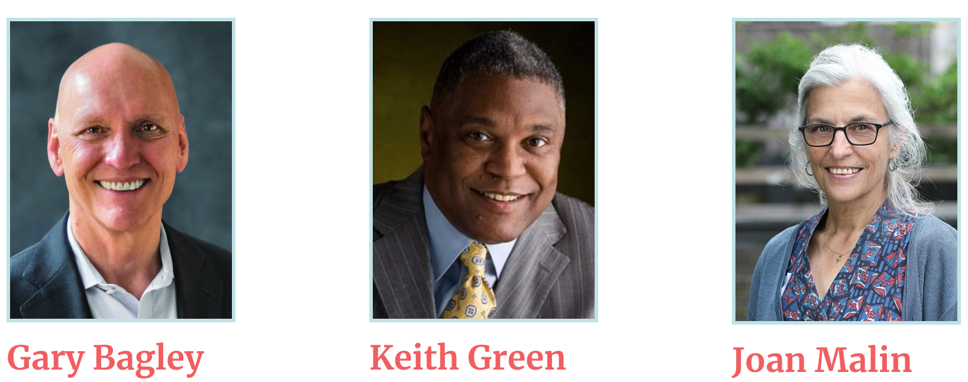
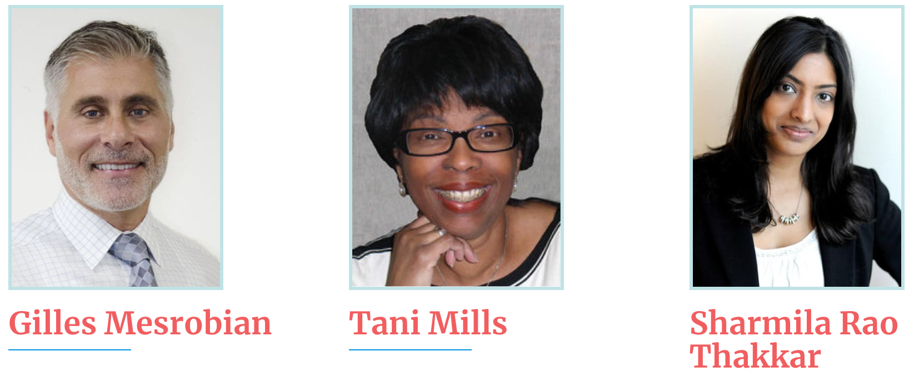
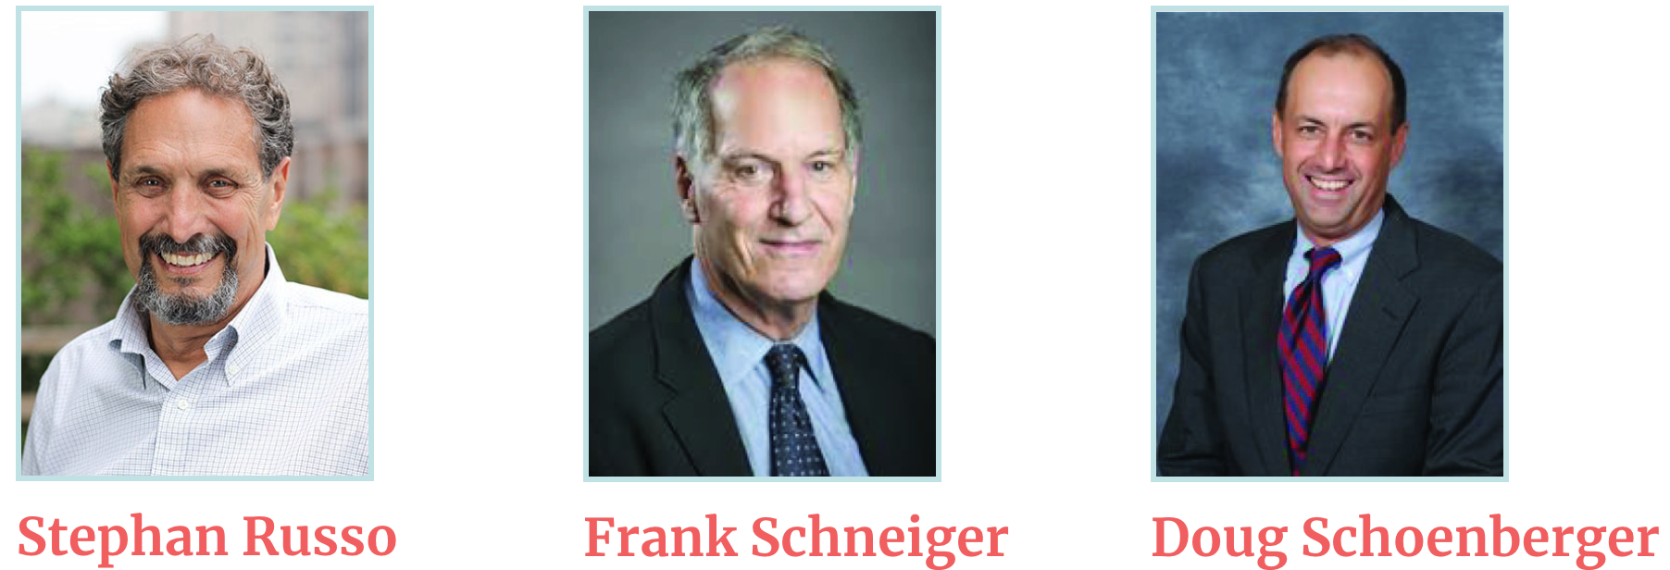
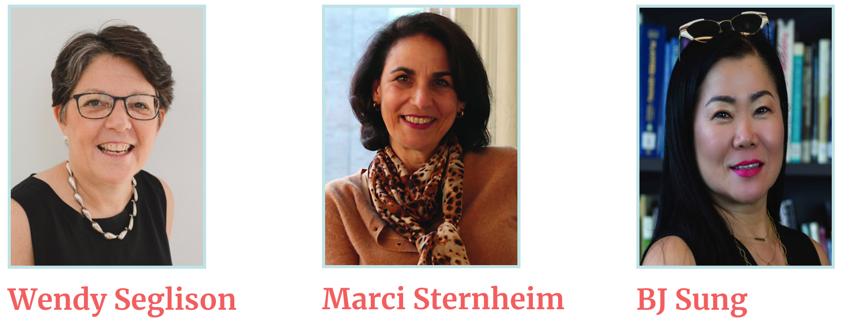
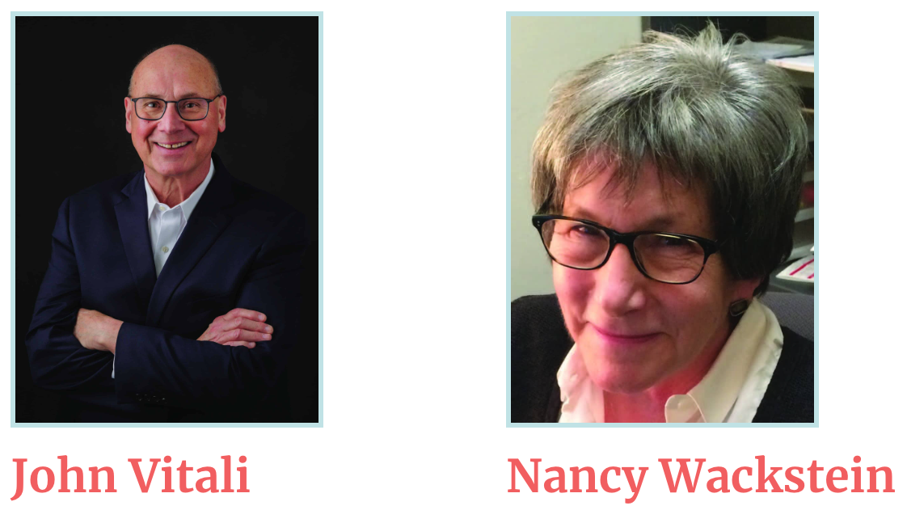
OUR
NAVIGATORS
Notes:
Navigators in the room should raise their hands.

Slide 8
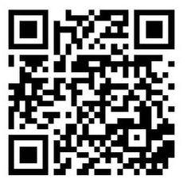
SUPPORT CENTER RESOURCES
WORKSHOPS
3 passes/organization to attend workshops.
Invitations to attend workshops with surplus seats.
Workshops include: grant writing, financial management,
public speaking, etc.
EXECUTIVE LEADERSHIP TRAININGS
Invitation to apply for the New Executive Director training program held twice a year.
Meets virtually on Thursdays: October 5th, 12th, & 19th from 12pm - 5pm.
Invitation to the Leadership Collaborative (scholarships available).
2024 Dates TBA .
OFFICE HOURS
One-hour office hour with Support Center executive staff or affiliates to discuss organizational challenges and possible solutions.
Notes:
QUICK POLL: Are they currently an ED?
Is this their first time as an ED?
Within their first 1-2 years as ED?

Slide 9
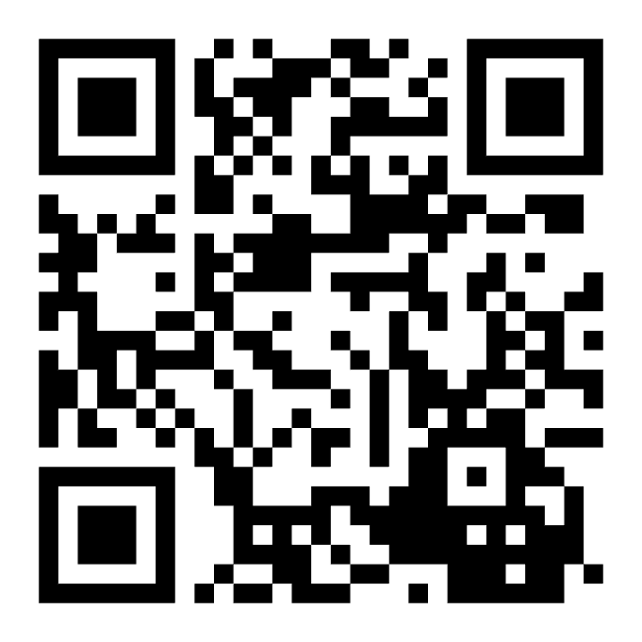
WORKSHOP SURVEY
WORKSHOPS
3 passes/organization to attend workshops.
Invitations to attend workshops with surplus seats.
Workshops include: grant writing, financial management,
public speaking, etc.
WHAT WORKSHOPS INTEREST YOU?

Slide 10
THANK YOU!

