Slide 1

SGO 2.0: from Compliance to Quality
Increasing SGO Quality through Better Assessments and Target Setting
Revised 9.1.14

Slide 2
1) All teachers set SGOs: 20%* of summative rating
Changes for SGOs in 2014-15
Teachers without an mSGP set two SGOs
Teachers with an mSGP set one or two SGOs
Teacher Practice
Teacher Practice
Student Growth Objectives
Student Growth Percentile
Student Growth Objectives
2) SGOs approved by supervisor by October 31

Slide 3
Note for Districts Using this Presentation and Resources
This presentation has been designed by the Department for use by educators in districts to help them increase SGO quality.
Read the notes below each slide carefully for additional information and context for the contents of the slides. (For PDF format, download file to view notes.)
Links to resources in PDF format are embedded in the presentation. Other formats are available on the AchieveNJ website SGO page.
Even though the contents of this presentation represent emerging best practices in SGOs and well established rules for assessment design, districts should understand that these are guidance materials only. They should be adapted and modified to meet district-specific needs and priorities.
For clarification on any of the topics covered by this presentation please visit http://www.state.nj.us/education/AchieveNJ/ or email educatorevaluation@doe.state.nj.us.
Notes:
The Department would like to acknowledge staff from the following organizations whose assistance was critical in the development of this workshop: Pequannock Township Public Schools, Clearview Regional High School District, the Reform Support Network, the Center for Assessment, and Relay Graduate School of Education.

Slide 4
Objectives for Today
Clarify what SGOs are and what they are not.
Develop a foundational understanding of how to develop and choose high quality assessments.
Investigate appropriate ways to set targets using readily available student data.
Develop a series of concrete next steps that will allow you to increase the quality of SGOs in your district.
Notes:
There is a great deal of information in this presentation, some aspects of which might appear to be very challenging to implement. Recognizing competing priorities, even within AchieveNJ, districts should carefully consider which components of the workshop they can realistically and effectively implement this year. Even if a district adopts just one recommendation, such as ensuring its assessments are aligned to critical standards, it has made a step in the right direction. A district can take more steps, as capacity allows, in continuously improving its educator effectiveness system.

Slide 5
Clarify what SGOs are and what they are not.
Part 1

Slide 6
Requirements for Student Achievement Measures
TEACHNJ Act
The standards for approval of educator evaluation rubrics at a minimum shall include:
a provision ensuring that performance measures used in the rubric are linked to student achievement.
A Student Growth Objective is an academic goal that teachers and evaluators set for groups of students.
It shall be specific and measurable, based on available student learning data, aligned to Core Curriculum Content Standards (or other standards adopted or endorsed by the State Board), and based on growth and/or achievement.
Notes:
The TEACHNJ Act signed into law in August 2012 requires that all teachers, principals, APs and VPs be evaluated using multiple measures including student achievement beginning in ’13-’14. The regulations adopted in September 2013 provide guidelines for the student achievement measures for teachers known as Student Growth Objectives. The Department has provided substantial guidance to help educators develop high quality SGOs that have value beyond their use as an accountability measure.

Slide 7
The Value of SGOs
For Educators
SGOs provide a method by which teachers can improve their practice through high quality goal setting while clearly demonstrating their effectiveness through the learning exhibited by the students for whom they are responsible.
For Evaluators
SGOs provide an authentic measure of teacher effectiveness that is aligned to the learning exhibited by students through an educator’s daily practice of teaching.
For Students
When well-designed, SGOs promote reflective and collaborative teaching practices, alignment among standards, instruction and assessment, and improve student learning.
Notes:
When developed thoughtfully and implemented well, SGOs provide benefit to teachers, their evaluators and, most importantly, their students.

Slide 8
What SGOs Are, and What They Are Not
#1
Misconception
Reality
SGOs need to be a significant addition to the work of a teacher.
SGOs should be a reflection of what effective teachers typically do.
Notes:
In many cases, SGOs in ’13-’14 were time-intensive as districts wrestled with the new SGO requirements in addition to the other components of AchieveNJ. However, most districts have learned a great deal during the first year of implementation and will have systems in place to build efficiencies into the SGO process. Most importantly, SGOs should simply document what effective teachers are already doing, rather than being a burdensome addition to the work teachers do on a daily basis.

Slide 9

SGOs should be a reflection of what educators typically do
SGO Quality Rubric - excerpt
Three of a Teacher’s Circles of Concern
Number of students in combined SGOs represents all or a large majority of the teacher’s students.
Includes start and stop dates that include a significant proportion of the school year/course length.
Includes a significant proportion of standards for which the teacher is responsible during the instructional period.
Assessment
SGO
Instruction
Standards
SGO Quality Rating Rubric
Notes:
SGOs are a point of convergence of standards, instruction, and assessment. Rather than being extra work, SGOs should be a way to help teachers focus on teaching the right standards in the right way, moving students to a set of clear learning goals, and effectively measuring how well they made it to those goals. Because SGOs should be an accurate reflection of a teacher’s work, they should include a significant proportion of the courses, standards, and students for which the teacher is responsible throughout the year. Decisions about the scope of SGOs should be grounded in practicality while being as representative of a teacher’s work as possible.
The SGO Quality Rating Rubric may be used as a tool to help teachers and supervisors develop high quality SGOs. The rubric should not be used to provide any type of official evaluation score for the teacher.

Slide 10

General and Specific SGOs
General Specific
Captures a significant proportion of the students and key standards for a given course or subject area
Focuses on a particular subgroup of students, and/or specific content or skill
SGO 1.0
2013-14
Most teachers will be setting this type of SGO
For teachers whose general SGO already includes all of their students, or those who receive an SGP
Notes:
In ’13-’14 the general/specific classification of SGOs created some obstacles to ensuring SGOs were reflective of a teacher’s typical work. The Department recommends discontinuing the use of this classification and instead encourages districts to focus on ensuring that between the two SGOs (which most teachers in the state have), a significant proportion of standards and students is captured.

Slide 11
2014-15 SGO Form
Name | School | Grade | Course/Subject | Number of Students | Interval of Instruction
 |  | 9 | Physics 1 | 55/55 | October-April
Rationale for Student Growth Objective Name the content standards covered, state the rationale for how these standards are critical for the next level of the subject, other academic disciplines, and/or life/college/career? Name and briefly describe the format of the assessment method.
Standards NJCCCS physical science 5.2.12 C, D and E NJCCCS science practices 5.1.12 A-D Impact of Standards This SGO includes all of the NJCCCS related to physics creating a foundation important for students who will take AP and/or college-level physics and is fundamental to many careers including architecture, mechanics, engineering, medicine. The SGO also includes all of the science practice standards, standards crucial in helping student become scientific thinkers. This mindset is valuable for making decisions when a large amount of information is available and must be analyzed for value and accuracy. It is critical in most academic disciplines. Assessment Physics department’s common assessment administered at the end of the 3rd marking period Written: 60 multiple choice (4 choice), 5 short response questions, Practical: Students design a simple apparatus, take measurements and collect data.
Significant proportion of students, standards and course
High quality test normally administered at this time
2014-15 SGO Form
Notes:
Having closely observed the successes and challenges of the SGO process in districts throughout ’13-’14, the Department has modified its optional SGO form to more clearly reflect critical components of the SGO process. In addition to removing general/specific categorization, this form asks educators to explain why the selected standards are critical for students. The example in the slide indicates that a large proportion of standards and students is captured by this teacher’s SGO and that an assessment process that falls within the framework of the normal testing schedule is used.

Slide 12
What SGOs Are, and What They Are Not
#2
Misconception
Reality
SGOs are driven by teachers, supported by administrators, and centered on student learning
SGOs are an administrator-driven compliance exercise
Notes:
The newness of the process combined with the technical challenges of developing SGOs for all teachers in ‘13-’14 provided a significant obstacle to high quality SGOs. Understandably, many districts chose to use a prescriptive method of SGO development for teachers to simplify the process and ensure it was completed. However, moving into ’14-’15, the Department reemphasizes that districts make SGOs a truly collaborative effort among teachers and administrators. Districts that encourage teachers to take ownership of the SGO process, including the assessments used to measure student learning, recognize SGOs as a powerful approach to improving teacher practice and student achievement.

Slide 13
SGOs are driven by teachers, supported by administrators, and centered on student achievement
Administrator-supported
Provide a supportive and collaborative environment
Assess quality and provide approval and final score of SGOs
Teacher-driven
Identify critical standards and develop assessments
Use appropriate data to set ambitious and achievable targets
Monitor performance and adjust instruction as needed
Student-centered
What should my students learn by when?
How will I ensure they learn it?
How will I know they have learned it?
Notes:
An SGO, as with any type of goal setting, works best when it is internally driven and yields a sense of autonomy rather than when imposed from outside. Principals are ultimately responsible for ensuring SGOs are rigorous (component 2d of the principal evaluation leadership rubric), but they should guide teachers to take ownership of the process. Both teachers and principals should view SGOs as a way to focus more strategically the real learning needs of students, delivering effective instruction to meet these needs, and using high-quality assessment to determine whether these needs have been met.

Slide 14
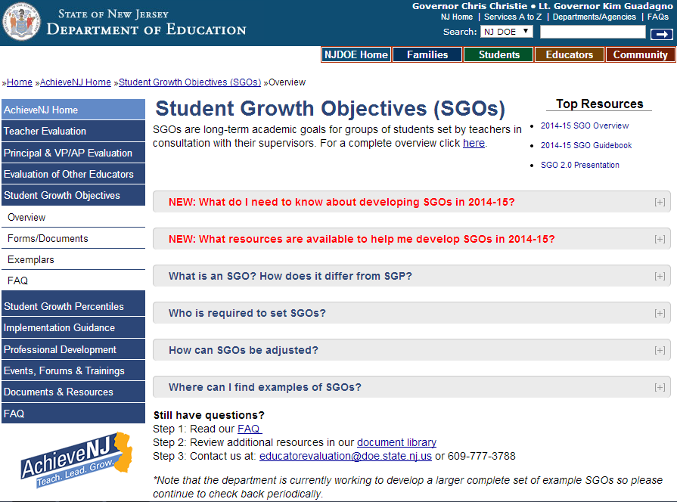
Updated Resources for 14-15

Slide 15

Develop a foundational understanding of how to develop and choose high quality assessments.
Part 2

Slide 16
Turn and Talk
What is the relationship between assessment quality and SGO quality?
Notes:
Activities such as this turn and talk are embedded throughout the workshop and can be removed or supplemented as time allows.

Slide 17
SGO
Quality
Assessment Quality
depends upon
  Poorly designed assessments do not accurately measure student knowledge and learning.
  If SGOs are based on low-quality assessments, then the SGO process cannot yield accurate or meaningful results.
  If SGOs do not yield accurate or meaningful results, they will fail to promote good instruction and improve student learning.
Notes:
This slide is the crux of the workshop. The ultimate purpose of SGOs is to help improve teacher practice and student learning, both of which is more likely occur when high quality assessments are used.

Slide 18
Types of Assessments for SGOs
Teachers may use but are not limited to:
Portfolios
Performance Assessments
Benchmark Assessments
Finals (modified as needed)
Program-based Assessments
Standardized Tests, e.g. AP
Whether locally-developed or commercial, multiple choice or rubric-based, assessments should follow the rules of good assessment design.
Notes:
This section uses multiple choice and short response examples to illustrate aspects of assessment design. However, when designing a rubric to measure a performance-based assessment or portfolio, for example, many of the following guidelines for validity and reliability can be applied.

Slide 19

What Does Good Assessment Look Like?
Notes:
It is a teacher’s professional responsibility to know what students know and can do before they leave their classrooms. Improving just one aspect of assessments is working in the right direction.
Click picture to access link on YouTube.

Slide 20
Elements of Assessment Design
Purpose
Assessment Design
Purpose
Accessible
Reliable/Consistent
Align to Standards
Valid/
Accurate Inferences
Range of Rigor/DOK
Note: The elements of assessment design have been updated for the 2015-16 school year. When accessing information about the elements of assessment design please consult the SGO 2.1 Presentation.
Note Taking Handout
Notes:
This portion of the workshop will address the six elements that need to be considered when designing a high-quality assessment.
See Assessment Design Note Taking Handout http://www.state.nj.us/education/AchieveNJ/teacher/AssessmentDesignNoteTakingHandout.pdf

Slide 21

Elements of Assessment Design
Begin with the End in Mind
Purpose
SGO assessments are measures of how well our students have met the learning goals we have set for them
Notes:
SGO assessments measure how well students have met the learning goals teachers have set for them. Educators must determine what learning goals are appropriate and necessary for their students by asking questions such as “What is our vision of student mastery?” and “Where is the finish line for our students?” Ideally, this discussion occurs between groups of teachers, and teachers and administrators, and aligns with district and school-wide priorities.

Slide 22
Elements of Assessment Design
Valid/Accurate Inferences
Assessment Design
Purpose
Accessible
Reliable/Consistent
Align to Standards
Valid/
Accurate Inferences
Range of Rigor/DOK

Slide 23

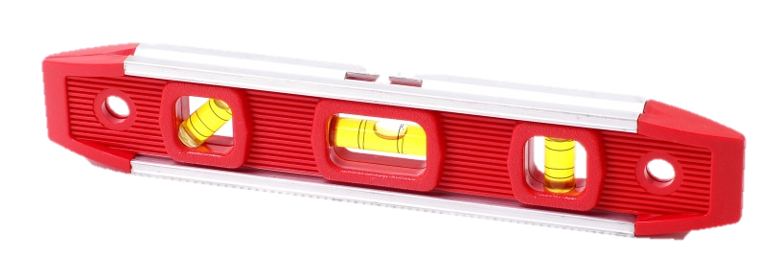


Elements of Assessment Design
Valid/
Accurate Inferences
Notes:
Metaphor –A carpenter must use a tape to measure the length of a wall, not a level. A level provides information about the wall but not the information the carpenter needs. If assessment items are not carefully designed, they will not provide the right information about student learning. In order to make valid/accurate inferences about student learning, the right tool has to be used.

Slide 24
Elements of Assessment Design
Valid/
Accurate Inferences
Valid/Accurate Inferences
Why does it matter? | The assessment should measure what it sets out to measure.
What does it look like? | The assessment is aligned to standards, skills, and rigor of the instruction and content of the course. The assessment is accessible to all students.
Notes:
Validity focuses on drawing appropriate conclusions from assessment results. Not only must the assessment be aligned to standards, it must reflect the skills and rigor of content taught in the course. All three components of validity will be discussed separately.

Slide 25
Elements of Assessment Design
Align to Standards
Assessment Design
Purpose
Accessible
Reliable/Consistent
Align to Standards
Valid/
Accurate Inferences
Range of Rigor/DOK

Slide 26
Analyze This Item
How valid is the inference we can make about student learning using this question?
How can we make this a better assessment item?
Perhaps the most famous of all the arts of the Ming Era was:
the elaborate puzzles of the period, which were popular even in Europe.
blue-and-white porcelain, which Europeans collected in great quantities.
the construction of large, elaborate palaces, the finest example of which is the Imperial City in Beijing.
high-quality Berber rugs, which are still popular today.
6.2.12.C.1.b - Trace the movement of essential commodities (e.g., sugar, cotton) from Asia to Europe to America, and determine the impact trade on the New Worlds economy and society.
Handout
Notes:
See Assessment Items for Validity and Rigor Discussion http://www.state.nj.us/education/AchieveNJ/teacher/AssessmentItemsForValidityAndRigorDiscussion.pdf

Slide 27
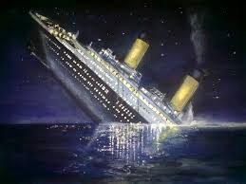
Notes:
Metaphor - Digging into the details of this assessment item and trying to improve it is like rearranging the deck chairs on the Titanic. It does not fulfill an important principle of item design – align to standards.

Slide 28
Item is not aligned to standards
6.2.12.C.1.b - Trace the movement of essential commodities (e.g., sugar, cotton) from Asia to Europe to America, and determine the impact trade on the New World’s economy and society.
essential commodities
arts of the Ming Era
Perhaps the most famous of all the arts of the Ming Era was:
the elaborate puzzles of the period, which were popular even in Europe.
blue-and-white porcelain, which Europeans collected in great quantities.
the construction of large, elaborate palaces, the finest example of which is the Imperial City in Beijing.
high-quality Berber rugs, which are still popular today.
Notes:
The standard relates to essential commodities, the item addresses art.

Slide 29
Elements of Assessment Design
Align to Standards
Given limited resources, especially time, on which standards do we focus our SGOs and assessments?
Notes:
It is important to acknowledge the reality of instruction and assessment. In many cases, teachers may not have time to teach everything they want to teach, but recognize there are certain foundational standards that are critical for students to know. These are the standards they spend more time teaching compared to those that have a lesser impact on the future success of students. Additionally, in most circumstances, it is impractical to develop and administer an assessment that accurately measures learning of all the information that has been taught over many months. This is why it is crucial to prioritize the standards that the assessment addresses.
Transition – There are two questions that can help make prioritization easier.

Slide 30
Elements of Assessment Design
Align to Standards
Determine the relative importance of the standard using the following criteria
How much time is spent teaching the standard?
Does the standard have value beyond the current course in:
  the next level of the subject,
  other academic disciplines, or
  life/college/career?
Notes:
This activity can include all standards taught during the year or simplified by identifying only those standards likely to be taught during the SGO period. In some cases, educators may want to ensure that particularly critical standards are included within the SGO period enabling extra focus through the SGO process.

Slide 31
Determine the relative importance of the standard being taught during the SGO period*
Standard Name
CCSS.ELA-LITERACY.RL.5.4 Determine the meaning of words and phrases as they are used in a text
CCSS.ELA-LITERACY.RL.5.6 Describe how a narrator's or speaker's point of view influences how events are described
CCSS.ELA-LITERACY.RL.5.9 Compare and contrast stories in the same genre
CCSS.ELA-LITERACY.RL.5.2 Determine a theme of a story, drama, or poem from details in the text
Rating* | Rank*
Rationale for Rating and Rank*
* Answers will vary based on many factors.
Notes:
There will be differences in opinion in this activity and variation will be based on the type of course you consider when teaching these standards, the starting points of students, priorities of the district etc. The point here is to have the conversation and work towards a shared understanding of teaching priorities that can then be reflected appropriately in the assessment.

Slide 32
Determine the relative importance of the standard being taught during the SGO period*
Standard Name
Rating | Rank
4 | 1st
4 | 2nd
2 | 3rd
2 | 4th
Assessment Design
More Questions/Points Fewer Questions/Points
Rating* | Rank*
Rationale for Rating and Rank*
* Answers will vary based on many factors.
Notes:
Using a ranking method forces important decisions about what is most important to teach given limited time and resources. It also forces prioritization during assessment writing when only a limited amount of time is available for the assessment.
For standards that are embedded throughout course, even though a number of days or percent of time might not be calculable, the importance of the standard is implied by its recurrent nature.
Presenter’s Note – do not get waylaid by a technical discussion based on differing opinions regarding the standards.
Point - In writing assessments, more questions and points should be assigned to more important standards – this ensures that more information about how well the students have learned these critical standards is available and allows them to demonstrate their mastery of the standards.

Slide 33
2014-15 SGO Form
Rationale for Student Growth Objective Name the content standards covered, state the rationale for how these standards are critical for the next level of the subject, other academic disciplines, and/or life/college/career. Name and briefly describe the format of the assessment method.
Standards
NJCCCS physical science 5.2.12 C, D and E
NJCCCS science practices 5.1.12 A-D
This SGO includes all of the NJCCCS related to physics creating a foundation important for students who will take AP and/or college-level physics and is fundamental to many careers including architecture, mechanics, engineering, medicine.
The SGO also includes all of the science practice standards, standards crucial in helping student become scientific thinkers. This mindset is valuable for making decisions when a large amount of information is available and must be analyzed for value and accuracy. It is critical in most academic disciplines.
Notes:
The importance of determining which standards will be taught and prioritized in the assessment is reflected in the modified language on the 2014-15 SGO form.
Transition – using an off-the shelf assessment might be a good option in some cases but it is important to ensure that it has good alignment, otherwise…(see next slide)

Slide 34

Using Commercial Products for SGOs
Notes:
Metaphor - Using commercial assessments for SGOs might be similar to a hammer looking for a nail. Having the assessment does not necessarily mean that the assessment will fulfill the purpose or intent of SGOs and may even hinder student achievement. Teachers and administrators should ensure that commercial assessments provide the type of instrument that accurately and appropriately measures the critical standards that students are learning.

Slide 35
Elements of Assessment Design
Range of Rigor/Depth of Knowledge
Assessment Design
Purpose
Accessible
Reliable/Consistent
Align to Standards
Valid/
Accurate Inferences
Range of Rigor/DOK
Notes:
Transition – in addition to aligning to standards, the assessment must also be aligned to the rigor of instruction and content of the course. The assessment should reflect the level and range of rigor of the course so that it accurately represents what has been taught and the level at which students should be able to demonstrate understanding. Also, the assessment should provide a range of access points to students who have different skill levels, thereby providing good information about students across a broad range of ability.

Slide 36
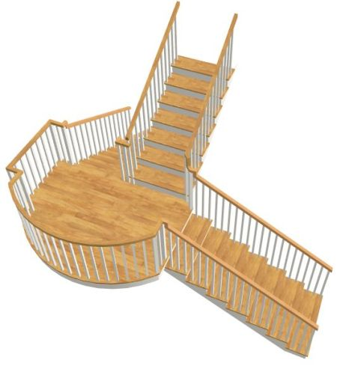
Elements of Assessment Design
Range of Rigor/DOK
Notes:
Metaphor - A house may have several floors that require climbing upstairs to get to higher levels. A high quality assessment (and course) allows students to demonstrate their understanding at different levels of cognitive complexity, from recall to extended thinking. This enables students of different ability levels to access the test at different points and the validity of the assessment by reflecting the nature of the course. This range and distribution of cognitive complexity should reflect the realities of the course. Asking high level questions on an assessment when this has not been demanded of the student in the course, and vice versa, reduces the quality of the assessment. When range of rigor parallels that of the course, this increases the validity of the inferences an educator can make from an assessment.

Slide 37
Elements of Assessment Design
Range of Rigor/DOK
Range of Rigor/Depth of Knowledge
Why does it matter? | An assessment that accurately reflects the range of rigor of the course and instruction increases the validity of inferences educators can make about student learning. Provides access points to students of varying ability.
What does it look like? | The assessment requires a range of thinking skills as proposed by Bloom’s taxonomy and Webb’s Depth of Knowledge (DOK) that reflects the rigor of the course.
Notes:
Using high-level and low-level questions in an assessment is sometimes referred to as “stretch.”

Slide 38
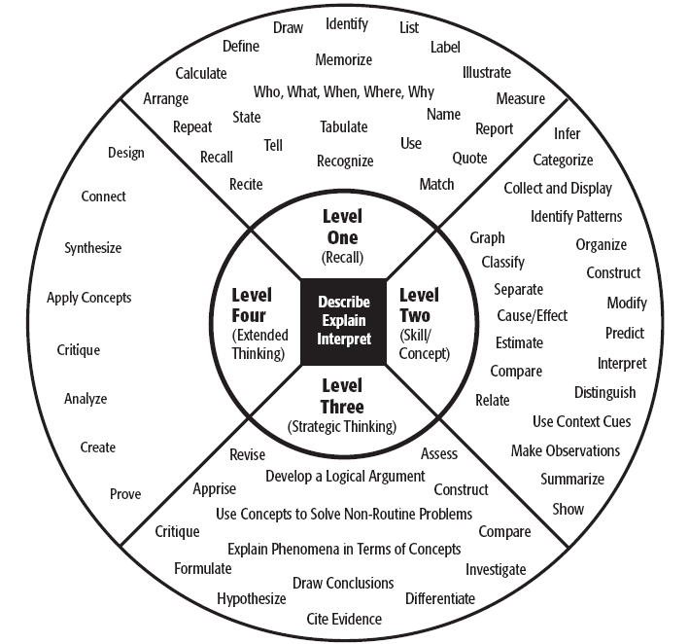
Elements of Assessment Design
Depth of Knowledge Wheel
Range of Rigor/DOK
4 minute video explaining DOK using the Gettysburg Address
Handout
Notes:
Video (see link in slide) provides examples of what four levels of DOK look like.
See DOK Wheel and Range of Rigor-DOK Form (form can be used to assess question rigor and write items of different DOK.)
http://www.state.nj.us/education/AchieveNJ/teacher/DOKWheelAndDOKRigorChartAndChecklist.pdf

Slide 39
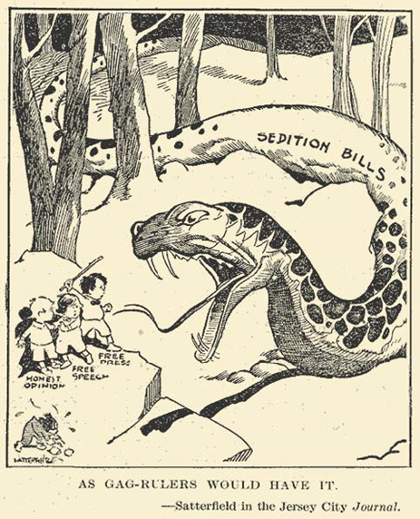
Determine the Rigor of this Item
What DOK level does this item represent?
What modifications could you make to the question to make it more rigorous?
Examine the following political cartoon and answer the following questions.
What does the snake in this cartoon represent?
Whom is the snake attacking?
Handout
Notes:
What and who questions are in level one DOK – recall.
Increasing the rigor of the question may be appropriate if many other questions are based at the same level.
See Assessment Items for Validity and Rigor Discussion
http://www.state.nj.us/education/AchieveNJ/teacher/AssessmentItemsForValidityAndRigorDiscussion.pdf

Slide 40
Determine the Rigor of this Item
What DOK level does this modified item represent?
Examine the following political cartoon. Use details from the cartoon to:
Explain the symbolism of the snake in the political cartoon.
Explain why the artist used children to represent free press, free speech, and honest opinion.
Notes:
This revision requires skills of explanation and interpretation – levels 2 and 3 on the DOK wheel.
It also asks students to use evidence from the cartoon to support an answer – Common Core skill.

Slide 41
Elements of Assessment Design
NOT Rigor for Rigor’s Sake
Range of Rigor/DOK
A high quality assessment has a range of rigor that:
Is representative of the rigor of instructional level and content delivered in the course, and
Provides stretch at both ends of ability levels
Notes:
A rule of thumb might be 1:1:1 for High:Med:Low rigor, but alignment with the range of course/instructional level is critical. Note: CCSS and the PARCC assessments require students to demonstrate their understanding at higher levels of rigor.

Slide 42
Elements of Assessment Design
Accessible
Assessment Design
Purpose
Accessible
Reliable/Consistent
Align to Standards
Valid/
Accurate Inferences
Range of Rigor/DOK
Notes:
Transition - Accessibility of the test is the third component of getting valid information from the test about student learning. Sometimes, certain test items or the construct of the assessment can yield inaccurate information about a student. For example, a math assessment may be constructed in a way that is more a measure of how well students read than a measure of how well they do math. In order to make valid inferences about student learning, the assessment must be ACCESSIBLE to all students regardless of extra-curricular background knowledge, personal experiences, culture and characteristics.

Slide 43
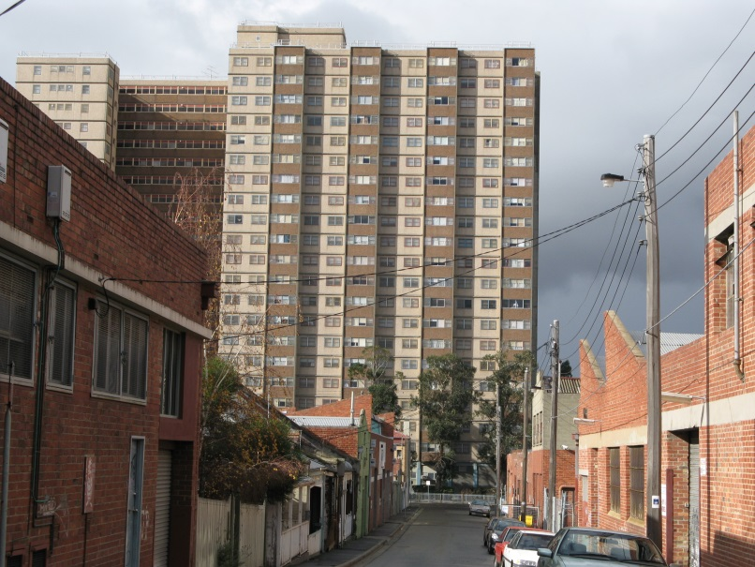
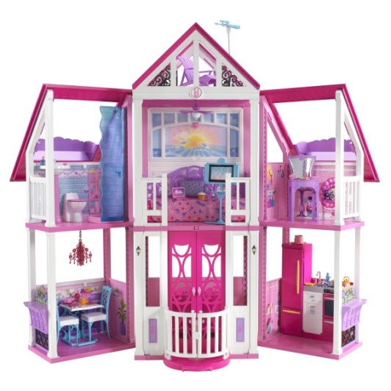


Elements of Assessment Design
Accessible
Notes:
Metaphor - The design of a house reflects certain cultural assumptions, and expectations of personal characteristics and background knowledge. Someone familiar with one particular type of dwelling may be unsure of how to navigate a different type of house designed with different expectations. Similarly, assessments can reflect culture and certain assumed knowledge. If students do not have the background knowledge or personal characteristics the test assumes, they may be disadvantaged when taking the test.
Example: Questions about skiing or sailing may disadvantage students who grow up in poverty and produce a negative reaction to the test in general
Example: Questions about a sport, TV show, book or movie, etc. may disadvantage students unfamiliar with the topic
Example: Small or blurry print in the assessment may disadvantage students who have vision problems.

Slide 44
Elements of Assessment Design
Accessible
Accessible Assessment
Why does it matter? | Promotes similar interpretations of the data. It’s fair to all students.
What does it look like? | Provides equal access to all students regardless of personal characteristics/background and pre-existing extra-curricular knowledge. Questions and structure do not disadvantage students from certain groups or those without particular background knowledge. Appropriate modifications for students with learning plans. Format, wording, and instructions are clear.
Notes:
Increasing accessibility reinforces validity of inferences that can be made about student learning.
When designing an assessment, educators must ask “What do students come to the test knowing?” and, “How might a student’s personal characteristics provide an advantage or disadvantage in answering a particular question?”
They must eliminate questions that require background knowledge not taught in the course or during previous courses and questions that unfairly penalize students because of students’ personal characteristics (e.g., race, gender, socioeconomic status or religion).

Slide 45
Examples
Directions:
Choose the one answer that best solves the problem.
If one card is taken at random from a deck of playing cards, what is the probability that the card will be an ace?
  8%
  50%
  25%
  10%
Directions:
Choose the one answer that best solves the problem.
There are 4 aces in a deck of 52 playing cards. If one card is taken at random from the deck, what is the probability that the card will be an ace?
  8%
  50%
  25%
  10%
Notes:
Suggested presentation of material:
Ask - To whom might this question be inaccessible? How would you change it?
Answer - Someone who has not played cards may need to be told how many cards are in a deck.

Slide 46
Examples
Directions:
Choose the one word or phrase that best completes the sentence.
The soldiers and their wives excitedly attended the _________.
  funeral
  celebration
  meeting
  workshop
Directions:
Choose the one word or phrase that best completes the sentence.
The soldiers and their spouses excitedly attended the _________.
  funeral
  celebration
  meeting
  workshop
Notes:
Ask - To whom might this question be inaccessible? How would you alter it to make it accessible to all?
Answer - Implying that all soldiers have wives may create a negative impression of the question because of the underlying stereotypes in the question. The second version is more inclusive.

Slide 47
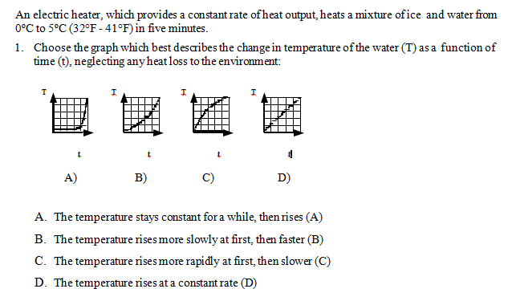
Examples
Notes:
Ask - Identify the components of this item that might make it inaccessible.
Answer - Several components in this item might reduce the accessibility of this question:
Small font on graphs
Blurry lines on graphs
Labeling of graphs – using A, B, C etc. makes multiple choice more confusing

Slide 48
Check for Understanding
Directions:
Choose the one word that completes the sentence.
Quarterbacks are often sacked during games _______ they do not have a good offensive line protecting them.
  even though
  although
  in spite of
  because
Directions:
Choose the one word or phrase that best completes the sentence.
Some students are often late to class _______ they visit their lockers too frequently.
  even though
  although
  in spite of
  because
Notes:
Ask
1) Evaluate the accessibility of the assessment item provided.
2) How can this item be adjusted to make it more accessible to students?
3) Share with others at your table.
Problems – Imprecise instructions, question relies on knowledge of football, biased in favor of those interested in sports, answer choices are difficult to read.

Slide 49
Elements of Assessment Design
Reliable/Consistent
Assessment Design
Purpose
Accessible
Reliable/ Consistent
Align to Standards
Valid/
Accurate Inferences
Range of Rigor/DOK
Notes:
The accuracy of the information that can be gained from a test is heavily reliant on the consistency of the assessment. We want to know that over time, with different students, and in various testing situations, the results of the test will yield the same information about students and be dependent on what the students know and can do rather than other factors that might shape their responses to the assessment.

Slide 50

Elements of Assessment Design
Reliable/ Consistent
Reliable
Unreliable
Notes:
Metaphor – Reliability is similar to the carpenter driving nails. Reliability is the consistency of where he drives the nails. Reliable is not the same as accurate, though, which is hitting the correct spot.
To be of high quality, an assessment must provide accurate results over a wide range of students and testing situations over time, just like a good carpenter will drive nails in the right spot consistently.

Slide 51
Elements of Assessment Design
Reliable/ Consistent
Reliable/Consistent Assessment
Why does it matter? | Provides information about student learning that can be trusted.
What does it look like? | Assessment administration and scoring is standardized and comparable. Assessment items yield consistent results over time.
Notes:
There are certain ways to improve reliability during one cycle of the assessment. Over several years, the reliability of the assessment can be monitored –the same questions producing the same results – and modified if consistency is lacking.
Transition – Consider some factors that contribute to reliability and lack thereof.

Slide 52
Several Ways to Increase Assessment Reliability
Ensure any preparation for assessment is consistent across teachers and students. Develop systems so that the same assessment is administered in the same way each time. Ensure scoring is done using clear criteria; use multiple scorers, cross-scoring and/or audits to increase consistency.
Notes:
See Department’s suggestions for developing a system of reliable test administration - http://www.state.nj.us/education/AchieveNJ/resources/AdministeringandScoringSGOAssessments.pdf

Slide 53
Check for Understanding
Day | Weight (lbs) | Scale | Time of Day
Monday | 130 | Bathroom | Morning
Tuesday | 130 | Bathroom | Morning
Wednesday | 130 | Bathroom | Morning
Thursday | 145 | Drs Office | Morning
Friday | 130 | Bathroom | Morning
How would you describe the reliability of this scale?
How about the validity of the information you get from it?
Notes:
Scale is reliable but probably does not lead to accurate inferences about the person’s weight. An assessment needs both consistency and reliability to be of high quality.

Slide 54
Elements of Assessment Design
Bringing the elements together into a coherent whole
Assessment Design
Purpose
Accessible
Align to Standards
Valid/ Accurate Inferences
Range of Rigor/DOK
Reliable/ Consistent
Blueprint
Notes:
Transition - There are several interrelated factors that must be considered when writing a high quality assessment, and each needs to be addressed during assessment development. A blueprint allows these factors to be organized into a coherent whole.

Slide 55
Elements of Assessment Design
Blueprint
PRIOR TO TEST DESIGN |  | DURING TEST DESIGN
Standard and Description of Standard (NJCCCS, CCSS, etc.) | Relative Importance of Standard 4= High 3= Medium-high 2= Medium-low 1= Low | Type of Question (multiple-choice, constructed-response, essay, etc.) | Depth of Knowledge of Question 4= Extended Thinking 3 = Strategic Thinking 2 = Skill/ Concept 1 = Recall | Question Number/ Points | Total Point Value/ Percentage of Test
4.NBT.B.4 Add and subtract multi-digit whole numbers | 4 | MC | 2 | #1/5 pts | 30 pts /10%
 |  | MC | 3 | #3/5 pts
 |  | CR | 3 | #6 /20 pts
Assessment Blueprint and Completion Guide
Notes:
The blueprint allows you to map out the assessment from the component level to the full assessment so that it accurately measures the most important learning during the instructional period.
See Assessment Blueprint and Blueprint Completion Guide
http://www.state.nj.us/education/AchieveNJ/teacher/AssessmentBlueprintandCompletionGuide.pdf

Slide 56
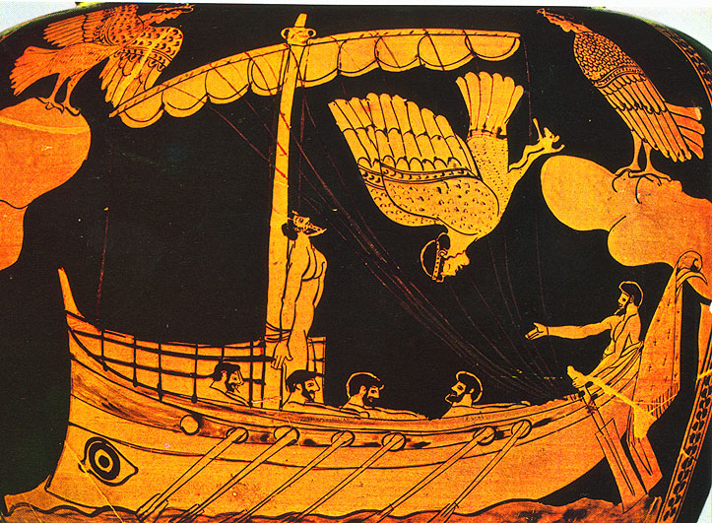
Investigate appropriate ways to set targets using readily available student data.
Part 3

Slide 57
Pre-tests - The Siren Song of Simplicity
Notes:
Metaphor – The Sirens provided an irresistible call to Greek sailors who then foundered on the rocks not realizing the dangers that were about to befall them. Similarly, it seems straightforward and appropriate to give a pre-test and then a post-test to see how much students have “grown.” However, this is technically very challenging to do well and works in only certain cases. There are many reasons to use this methodology with caution when setting SGO targets.

Slide 58
What SGOs Are, and What They Are Not
#3
Misconception
Reality
SGOs are learning targets for key concepts and skills that students can be expected to master in a course based on a rough sense of where they start.
SGOs are a statistically precise measure of growth based on a pre-test/post-test model of performance.
Notes:
The reality of SGOs may require a shift in thinking of teachers and administrators who have heavily relied on a pre-test post-test model. However, using a so-called “rough conditioning” approach provides value to the SGO process, makes it more reflective of the typical effective teacher, and allows more authentic student learning goals to be set.

Slide 59
Important Considerations if Using the Pre-test Post-test Model
Reliability of Assessment Data Especially in Pre-test
“Don’t worry about it – this doesn’t count.”
Lack of Value for Instructional Purposes
“Yep, just as I thought – my kids don’t know any Mandarin yet.”
Difficult to Set Reasonable Targets
Impossible to extrapolate future learning from one data point.
Notes:
Test design and administration are very important – The information in part 2 of the workshop should highlight the demands of creating and administering high-quality assessments that reduce error and increase the validity of the inferences a teacher can make about student learning. There may be significant challenges, especially when giving pre-assessments at the beginning of the year, to collecting reliable and useful information about students’ starting points.

Slide 60
Predicting Student Learning Based on a Rough Sense of Where They Begin
?
?
?
Expected learning cannot be determined using one data point.
Expected learning is better- determined using multiple measures of starting points.
Notes:
Multiple data points allow you to better estimate the trajectory of the students. One data point means you’re taking a blind shot. In the case of the graph on the right, the different trajectories of two students can be determined by using three types of information. This information is used to set learning goals for the students that, in this case, are different. These differentiated goals (or tiered SGOs) were widely used in New Jersey in ‘13-’14. The Department recommends this approach for setting ambitious and achievable goals.

Slide 61

Predict the Final Picture
Notes:
Metaphor - One puzzle piece doesn’t provide enough information with which to predict the shape of the final picture. Similarly, having only one measure of students’ starting points (e.g. pre-tests) provides inadequate information about their future success.

Slide 62

Predict the Final Picture
Notes:
More pieces adds information and makes it easier to predict the final outcome.

Slide 63

Predict the Final Picture
Notes:
More pieces gives a clearer idea (though not complete) of what the picture will look like. This is what is meant by “rough conditioning.”

Slide 64
  List the information you have used or could potentially use to determine students’ starting points.
Notes:
Ask for ideas.

Slide 65
  List the information you have used or could potentially use to determine students’ starting points.
Current grades
Recent test performance
Previous year’s scores
Well-constructed and administered, high-quality pre-assessments
Important markers of future success
Notes:
This is just a selection of potential sources of data.

Slide 66
Sample Rubric for Important Markers of Future Success
Criterion | Level 4 | Level 3 | Level 2 | Level 1
Active Participant | Always prepared Engaged in all of the learning process | Mostly prepared Engaged in most of the learning process | Sometimes prepared Engaged in some of the learning process | Rarely prepared Engaged in little or none of the learning process
Academic Independence | Consistently demonstrates intellectual curiosity Consistently self-motivated and independent | Frequently demonstrates intellectual curiosity Usually self-motivated and independent | Sometimes demonstrates intellectual curiosity Sometimes self-motivated and independent | Rarely demonstrates intellectual curiosity Rarely or never self-motivated, frequently depends on prompting and/or teacher assistance
Class Attendance | Never absent | Rarely absent | Sometimes absent | Frequently absent
Rubric for Important Markers of Future Success
Notes:
Markers of future success can be used as one measure of starting points. This can be modified by districts as needed.
See Resource Packet - Sample Rubric for Important Markers of Success http://www.state.nj.us/education/AchieveNJ/teacher/SGOQualityRatingRubric.pdf

Slide 67
Physics 1 SGO Using Multiple Measures of Starting Points to Determine Three Groups*
Student ID | Prior Year Final Grade | Current Year Test Scores | Markers of Future Success |  |  | Preparedness Group
 | Math | Average Score | Participates in Class | Completes Homework | Number
1 | 86 | 98.5 | Yes | No | 1 | 1
2 | 73 | 92.5 | Yes | Yes | 2 | 1
3 | 96 | 95 | Yes | Yes | 2 | 1
4 | 92 | 85.5 | Yes | No | 1 | 1
5 | 67 | 54 | No | No | 0 | 3
6 | 69 | 58 | No | No | 0 | 3
7 | 78 | 72.5 | Yes | No | 1 | 2
8 | 94 | 80.5 | No | No | 0 | 2
Prior Year Math Grade | Current Year Test Score Average | Number of Future Success Markers | Preparedness Group
<70 | <70 | 0 | 3
70 – 84 | 70 – 84 | 1 | 2
85 – 100 | 85 – 100 | 2 | 1
The teacher may assign a specific preparedness group when a majority of measures indicate a specific group using the guide at left.
* May be more or fewer than three groups
8
Notes:
There are other methods by which to group students based on multiple measures. For example, you might weight components differently based on their relative importance. Providing a numerical score for each preparedness category can also be effective.
See this social studies SGO for an example of this method. http://www.state.nj.us/education/AchieveNJ/teacher/SocialStudiesUSHistoryGrade8.pdf

Slide 68
Determine Appropriate Learning Targets
Determine the level of performance on the assessment that would indicate a sense of competence/mastery of the content and skills.
Modify learning targets so they are ambitious and achievable for the preparedness level of the students .
Student Growth Objective*
85% of students will meet their learning targets as shown in the table below.
Preparedness Group (e.g. 1,2,3) | Number of Students in Each Group | Target Score on SGO Assessment
1 | 31 | ≥90
2 | 63 | ≥80
3 | 16 | ≥75
4 | 15 | ≥65
*This table has an extra row for four preparedness groups.
Notes:
Begin with the end in mind - Where do you want your students to end up? What do you want them to know and be able to do by the end of your course? This is a finish line – or score – that you set and measure with your SGO. If all students came equally prepared and with equal abilities, they may all have the same finish line. However, because students vary, having different finish lines recognize factors that may affect student performance. Historically, teachers have implicitly (or explicitly) set learning goals and expectations for their students through expected grade distributions and performance on summative assessments, for example. Determining what a student must do to achieve an “A” or the minimum competence to achieve a passing grade, or a “D,” is typical work for all teachers. In SGOs, having a rough sense of where students start allows students to be grouped according to predicted future performance. Teachers must have a good sense of the rigor of the assessment and a target score that would demonstrate mastery. In many cases, they have historical performance on the assessment or one that is similar. The target scores are differentiated by student preparedness groupings. Note: In many cases, teachers may set more ambitious learning goals for students who are not performing at grade level at the beginning of the year, in order to help them catch up.

Slide 69
Appropriate Role of the Pre-test/Post-test
Model in SGOs
Where improvement in a set of skills is being evaluated
When assessments are high quality and vertically aligned
When pre-tests are normally used for diagnostic purposes
In combination with other measures to help group students according to preparedness level
Grade 1 Reading - DRA
Student | Initial DRA Level | High Frequency Word Recognition | Markers of Future Success | Preparedness Group | DRA Target
1. | 3 | 25 | 5 | 2 | 14-16
2. | 3 | 35 | 10 | 1 | 16-18
3. | 3 | 26 | 8 | 2 | 14-16
Notes:
In this example for a first-grade teacher, using the DRA test at the beginning of the year can yield important information about a student’s reading ability but other information should be used to help predict how far they should be able to move within the instructional period. Note: In many cases, teachers may set more ambitious learning goals for students who are not performing at grade level at the beginning of the year to place a special focus on helping them catch up.
Another Example – an English teacher measures writing skills of her students at the start of the year using a prompt and well-designed rubric. She combines this information with two other measures – grades to date and prior-year writing portfolio score – to set goals for the students. She also uses information from this assessment to guide her instruction and periodically checks on progress on the skills throughout the year. She administers the assessment at the end of the year using the same rubric with a similar prompt.

Slide 70
Sample Scoring Plan for Students with Varied Starting Proficiency*
Preparedness Group | Attainment Level in Meeting Student Growth Objective Student Proficiency Growth on Reading Assessment (years)
 | Exceptional 4 | Full 3 | Partial 2 | Insufficient 1
More than 2 years below grade | ≥2.0 | ≥1.5 | ≥1.0 | <1.0
1 to 2 years below grade | ≥1.5 | ≥1.25 | ≥1.0 | <1.0
Above grade level to 1 year below grade level | ≥1.25 | ≥1.0 | ≥0.75 | <0.75
* More information than just reading level should be used when determining appropriate targets. Individualized targets could be used if students don’t fit into clear categories.
Notes:
The educator in this sample sets herself a goal to help her students catch up to their peers who are at grade level.

Slide 71
Determine Teacher’s SGO Score
Use and adjust ranges of student performance to derive a score that accurately reflects teacher’s effectiveness while taking into account the fluid nature of teaching and learning.
Scoring Plan*
Preparedness Group | Student Target Score on Assessment | Teacher SGO Score Based on Percent of Students Achieving Target Score
 |  | Exceptional (4) | Full (3) | Partial (2) | Insufficient (1)
1 | ≥90 | ≥90% | ≥80% | ≥70% | <70%
2 | ≥80 | ≥90% | ≥80% | ≥70% | <70%
3 | ≥75 | ≥90% | ≥80% | ≥70% | <70%
4 | ≥65 | ≥90% | ≥80% | ≥70% | <70%
*This table has an extra row for four preparedness groups. Percentages and target scores are for illustrative purposes only . Educators should tailor these numbers to best reflect their situations.
Notes:
Providing a range for the number or percentage of students achieving a particular score (10 point brackets in the case above, but this could be more or less depending on district, school, and classroom needs) recognizes that teaching and learning is a fluid process. In addition to building in margins in the scoring plan, educators should remember that, if warranted, targets may be adjusted up until February 15 with superintendent approval based on information gathered prior to this date. Supervisors are responsible for determining the final SGO score using the agreed-upon and approved SGO scoring plan and assessment. However, in rare instances where there have been significant changes in a teacher’s class that affect the teacher’s SGO score, such as truly exceptional or unusual circumstances leading to poor teacher or student attendance, the supervisor may use his or her professional judgment to provide a fair and accurate score.

Slide 72
Consider Tailoring SGOs and Scoring Plans for Different Situations
Small Class Size | Full Attainment of Objective (3 points)
Number of students per group attaining differentiated learning targets | At least 5/7 students in group 1 will score 85% on assessment.
Proportion of students meeting individual goals | 75% of the 12 students in class will attain their individual learning targets.
Average proficiency score in the class by group or overall | The average score of the six students in the class will be 80%.
Resource Room | Exceptional Attainment of Objective (4 points)
Account for students who graduate from a short-term program | Students will achieve a score of 90% or graduate from the program.
Scoring Plans with Finer Increments
Score | 4.0 | 3.5 | 3.0 | 2.5 | 2.0 | 1.5 | 1.0
% Students | ≥95 | ≥85 | ≥80 | ≥75 | ≥70 | ≥65 | <65
Notes:
As long as SGOs are academic in nature, set for growth and/achievement targets that are specific and measurable, aligned to standards, based on available student learning data, and result in a score on a 1-4 scale, there is a wide variety of options for goal setting open to educators. Teachers should explore the options that best suit their needs and particular teaching assignment.
Examples of different approaches can be found in the SGO guidebook
http://www.state.nj.us/education/AchieveNJ/teacher/14-15SGOGuidebook.pdf

Slide 73
Part 4
Develop a series of concrete next steps that will allow you to increase the quality of SGOs in your district.
Notes:
Recognizing competing priorities, even within AchieveNJ, districts should carefully consider which components of the workshop they can effectively implement this year. Even if a district adopts just one recommendation, such as ensuring its assessments are aligned to critical standards, it has made a significant step in the right direction. A district can take more steps, as capacity allows, in continuously improving its educator effectiveness system.

Slide 74
Possible Next Steps
Share information from this workshop with all members of your DEAC and develop a strategy for developing higher quality assessments and SGOs throughout the district.
Review the materials from this workshop and plan the time and method for delivering to staff in a PD session.
Ask building leaders to create an SGO assessment inventory and check quality against the elements of assessment design and item design rules.
Ask teachers to identify 3 sets of data to determine student starting points.
Build in time during PLC/team time for assessment development.
Use the SGO quality rating rubric to determine quality of SGOs during the approval process (deadline - October 31st, 2014).
Activity Handout

Slide 75
Resources
Updated SGO guidebook and forms
Expanded SGO library
FAQs
ScIP Workshops
Information
www.nj.gov/education/AchieveNJ
Questions
educatorevaluation@doe.state.nj.us
609-777-3788

