Slide 1
AchieveNJ: a Tool for Improving Teaching and Leading
Office of Evaluation
Division of Teacher and Leader Effectiveness
Summer 2017

Slide 2
Agenda AchieveNJ: A Tool for Improving Teaching and Leading
Using Accurate Evaluations to Inform Quality Professional Development Pete Mazzagatti
Principal evaluation: Reframe and Align to Strengthen Leadership Paul Palek
Evaluating, Supporting and Retaining Highly Effective Teachers Chelsea Collins

Slide 3
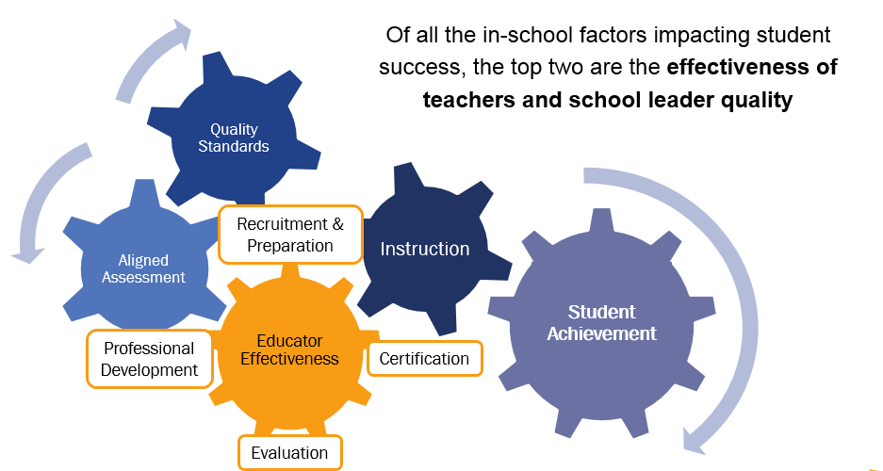
Improving Student Achievement Through Better Instruction

Slide 4
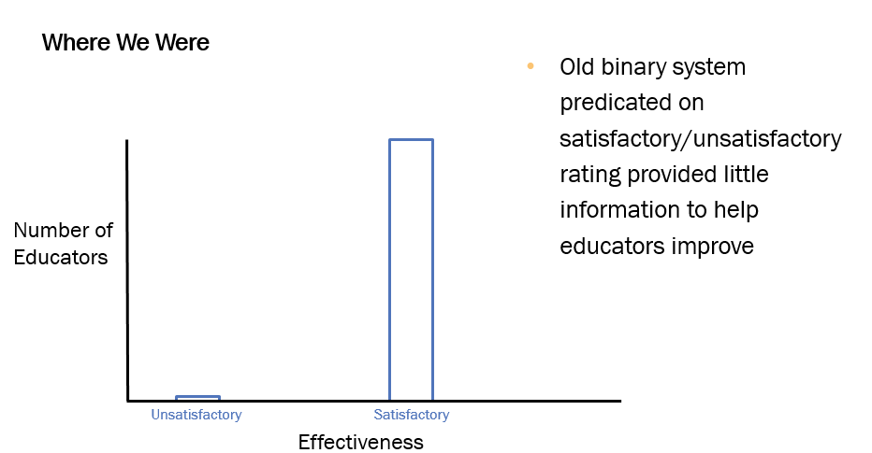
AchieveNJ: A Tool for Improving Teaching and Leading (slide 1 of 3)

Slide 5
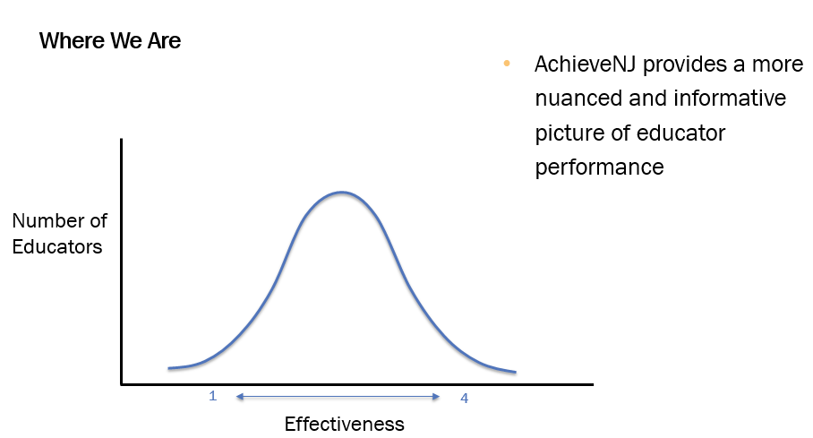
AchieveNJ: A Tool for Improving Teaching and Leading (slide 2 of 3)

Slide 6
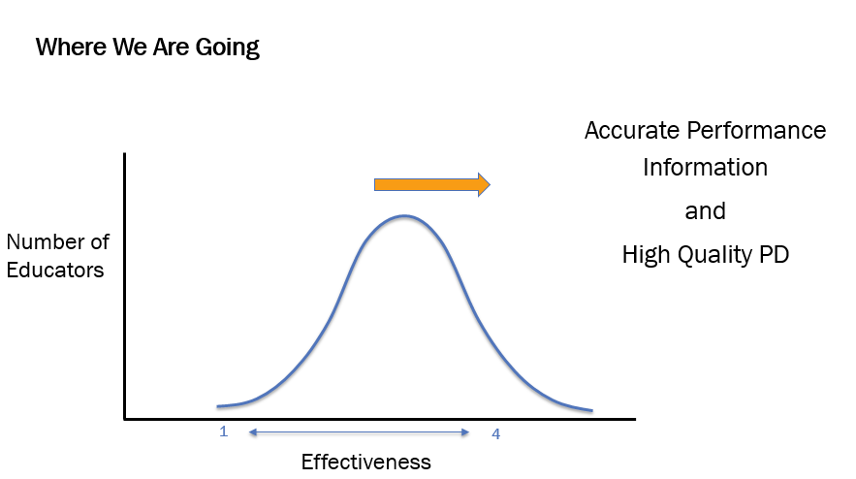
AchieveNJ: A Tool for Improving Teaching and Leading (slide 3 of 3)

Slide 7
Hard Work is Paying Off: Teacher Evaluation Ratings are Improving
Since 2013, there are more Highly Effective teachers and fewer Partially Effective and Ineffective teachers
Our best teachers are still teaching (~95%)
Struggling teachers are improving (2/3) or leaving (1/3)
Thousands of teachers have improved over the past three years

Slide 8
How Is AchieveNJ Working?
Expectations for good teaching have been clarified
The observation process allows for improved conversations and feedback
Student and teacher data is being used to improve teacher practice

Slide 9
Growth Areas in Evaluation
Area | Objective
Teacher Evaluation | Use accurate evaluations to inform quality professional development
Principal Evaluation | Reframe observations and align components to strengthen school leadership
Highly Effective Teachers | Elevate, support and retain the best teachers to strengthen the educational community

Slide 10
Teacher Evaluation Using Accurate Evaluations to Inform Quality Professional Development
Office of Evaluation
Division of Teacher and Leader Effectiveness
Summer 2017

Slide 11
Agenda (Using accurate Evaluations to inform quality professional development(
Improved Teaching
Accurate Evaluation
Quality Professional Development
In this session, we will discuss ways that teacher evaluation can be used to continue to strengthen teaching
Improving accuracy of evaluation scores
Aligning evaluation results to meaningful professional development plans
Leveraging ScIPs to provide strong professional development and support for staff particular novice teachers

Slide 12
The Value Of Accurate Data
Data and World Health

Slide 13
Observation Scores In Two Districts
Which data set is more likely to tell a school district “where to go and how to act?” Why?

Slide 14
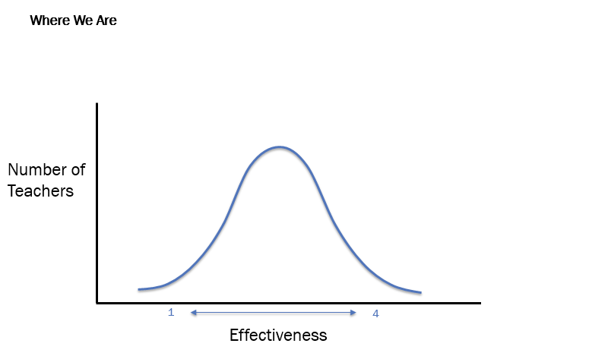
Teacher Evaluation: A Tool For Improving Teaching

Slide 15
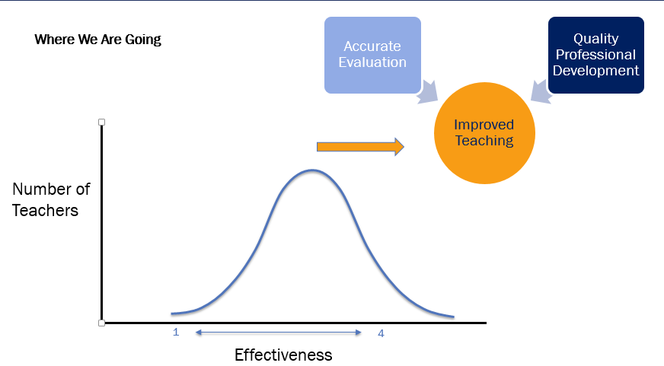
Teacher Evaluation: A Tool For Improving Teaching

Slide 16
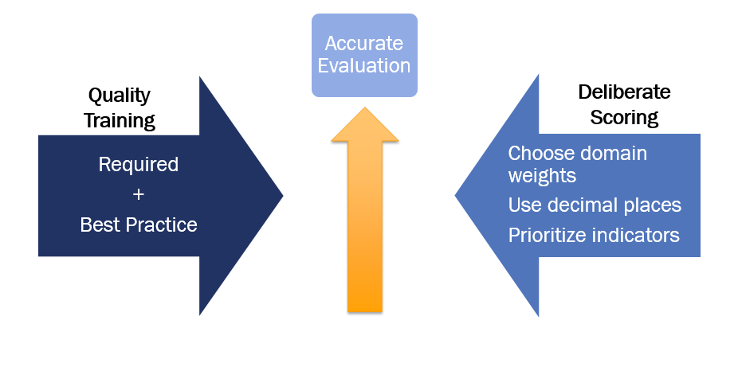
Improving Observation Score Accuracy

Slide 17
Quality Training
Required
Annual updates and refresher training on practice instrument prior to observations
More thorough training for new evaluators
Two co-observations per year
Best Practice
Approach observation training as a cycle of continuous improvement
Use a variety of calibration activities
Establish protocols for evaluation components including pre- and post-conferences (guidance)
Use effective training to ensure that teachers fully understand how the practice instrument describes excellent teaching
+

Slide 18
Quality Training: Using Required Training Plus Best Practices To Drive Continuous Improvement (slide 1 of 3)
Analyze evaluation data: plan training
January
July/Aug
September
November
May/June
Train observers on practice instrument
Conduct video observation activity
Conduct video observation activity
Conduct Observations
Engage in observation review activity
Participate in co-observations

Slide 19
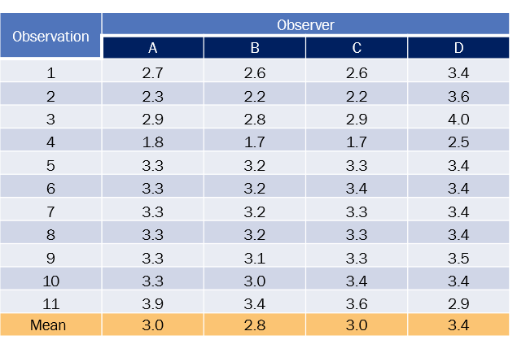
Quality Training: Using Required Training Plus Best Practices To Drive Continuous Improvement (slide 2 of 3)
Analyze evaluation data: plan training
What action does this initial analysis suggest?

Slide 20
Quality Training: Using Required Training Plus Best Practices To Drive Continuous Improvement (slide 3 of 3)
Analyze evaluation data: plan training
January
July/Aug
September
November
May/June
Train observers on practice instrument
Conduct video observation activity
Conduct video observation activity
Conduct Observations
Engage in observation review activity
Participate in co-observations

Slide 21
Quality Training: Using A Variety Of Calibration Activities
Activity | Step 1 | Step 2 | Step 3 | Step 4
Video Observation | Select a classroom video | Collaboratively view the video and individually collect high quality evidence | Assign the evidence to standards and provide scores | Debate and discuss scores until consensus is reached
Observation Report Review | A school leader presents a classroom observation at a leadership team meeting | Individually read and score the observation report using the observation quality rubric | Resolve all questions | Debate and discuss component level ratings and rationale
Co-observation | Establish a procedure for pairing or grouping school administrators | Collectively observe and individually record evidence | Independently sort the evidence and score each component | Reconvene to share and discuss component-level ratings and rationale
Complete guidance including scoring debrief norms
Observation Quality Rubric

Slide 22
Deliberate Scoring (slide 1 of 2) (slide 1 of 2)
Scoring Requirements
Teacher practice score determined through a state-approved practice instrument
Practice score must be between 1 and 4
District Discretion
List the aspects of scoring that you have discretion to decide.
+

Slide 23
Deliberate Scoring Slide (2 of 2) (slide 2 of 2)
Scoring Requirements
Teacher practice score determined through a state-approved practice instrument
Practice score must be between 1 and 4
District Discretion
Relative weights of practice domains
Use of decimal places to determine observation score
Prioritization of rubric standards
+

Slide 24
Deliberate Scoring: Weighting Domains*
Scoring weight decisions can have a significant impact on final scores
Choose weights that best reflect the priorities of your school/district
 | I Planning and Preparation | II Classroom Environment | III Instruction | IV Professional Responsibilities | Practice Score
Weight 1 | 30% | 30% | 30% | 10% | 100%
Score 1 | 2.7 | 2.6 | 2.5 | 3.0 | 2.6
Weight 2 | 25% | 25% | 25% | 25% | 100%
Score 2 | 2.7 | 2.6 | 2.5 | 3.0 | 2.7
* “Domains” refers to large groups of measures associated with teaching practice. Practice instruments use a variety of terms to describe these groups. Example of domains taken from Danielson. Weights used for illustrative purposes. only.
Compare the scores at each weight? What do you notice?
* “Domain” refers to a large group of practices associated with teaching. Practice instruments use a variety of terms to describe these groups. Example of domains taken from Danielson. Weights used for illustrative purposes only.

Slide 25
Deliberate Scoring: Using Decimal Places To Determine Domain Scores
Using decimal places (D.P.s), i.e. not rounding, provides more information within an evaluation
Component | Rating in Domain 2/Classroom Environment |  |  |  | Domain Score
 | Ineffective | Partially Effective | Proficient | Distinguished | Calculation | Rounded | One D.P.
2A |  |  | 3 |  | 3+2+2+3+3 5 | 3 | 2.6
2B |  | 2
2C |  | 2
2D |  |  | 3
2E |  |  | 3
How would providing a score with one decimal place practically add value to the observation process?
Example of practice language taken from Danielson. Scores used for illustrative purposes only.

Slide 26
Deliberate Scoring: Using Decimal Places To Determine Domain Scores (slide 2 of 2)
Using decimal places may reveal more specific areas of growth
More deliberate scoring shows certain teachers could benefit from specific PD or more intensive supervision, generally, e.g. Corrective Action Plan
Scoring Method |  | Planning (30%) | Environment (30%) | Instruction (30%) | Professionalism (10%) | Practice Score
Teacher A | Rounded | 3 | 3 | 3 | 3 | 3
 | 1 D.P. | 2.7 | 2.6 | 2.5 | 3.0 | 2.6
Teacher B | Rounded | 3 | 3 | 3 | 3 | 3
 | 1 D.P. | 3.1 | 3.3 | 3.4 | 3.2 | 3.3
What would be your recommendation for the teachers shown above based on their alternative scores?

Slide 27
Deliberate Scoring: Prioritizing Components* By Evaluating These Each Observation (Example Shown Is For Illustrative Purposes Only And Is Not A DOE Recommendation)
Every Observation
Observation 1
Respect and Rapport Culture for Learning Communicating with Students Engaging Students in Learning Responsiveness and Flexibility
Observation 2
Respect and Rapport Culture for Learning Communicating with Students Engaging Students in Learning Responsiveness and Flexibility
Observation 3
Respect and Rapport Culture for Learning Communicating with Students Engaging Students in Learning Responsiveness and Flexibility
At Least Once
Managing Classroom Procedures Managing Student Behavior Organizing Physical Space Using Questioning and Discussion Techniques Using Assessment in Instruction
What particular aspects of teaching do you look for in every observation?
* “Components” refers to specific areas of practice specified in observation instruments. Components are aligned to INTASC standards and cross cut all approved instruments.

Slide 28
Observation Scores In Two Districts (continued)
What is one suggestion you have for District 1 for how to use deliberate scoring in improving accuracy?

Slide 29
Improving Observation Score Accuracy (continued)
What is one concrete action step you are planning to take or might suggest your district take to increase scoring accuracy?

Slide 30
Evaluations Inform Professional Development
Evaluation data should be used individually and at a school level for professional development purposes
Teachers and Evaluators
Individual Teacher Data
Aggregate School Data
Teacher Professional Development Plan
School Improvement Panel (ScIP)
School Professional Development Plan
Accurate Evaluations

Slide 31
Individual Professional Development Must Be Informed By Performance Evaluations
Stated goal of the TEACHNJ Act
“Raise student achievement by improving instruction through the adoption of evaluations that provide specific feedback to educators, inform the provision of aligned professional development, and inform personnel decisions.” ~C.18A:6-118
Revised QSAC Indicators*
2a. An audit of personnel files indicates that required individual professional development plans (PDPs) or corrective action plans (CAPS) are aligned to the professional standards for school leaders or teachers and have been completed for administrators and teachers and are linked to (1) school district, school, team, and/or individual goals, and (2) results from individual performance evaluations. (N.J.A.C. 6A:9C and 6A:10-2.5);
*Pending adoption by State Board in Fall 2017

Slide 32
Professional Learning Aligned With The Evaluation Cycle
Summer PD
Attend workshops, review literature
Summary Conference
Review PDP progress, plan revisions
First Month of School
Collect student data, determine instructional priorities
September
April
Finalize PDP Goals
Discuss in conjunction with SGOs
October 31
Pre-observation Conference
Determine look-fors related to PDP
Videotape Classroom
Self-reflect on progress
December
February
Peer Observation
Collaborate with others to get and give feedback
Post–observation Conference
Discuss progress on goal

Slide 33
PDP Goal Setting Example ]Slide 1 of 2
3c: Engaging Students in Learning | Developing | Proficient
 | The learning tasks and activities are partially aligned with the instructional outcomes but require only minimal thinking by students and little opportunity for them to explain their thinking, allowing most students to be passive or merely compliant. | The learning tasks and activities are fully aligned with the instructional outcomes and are designed to challenge student thinking, inviting students to make their thinking visible. This technique results in active intellectual engagement by most students with important and challenging content, and with teacher scaffolding to support that engagement.

Slide 34
PDP Goal Setting Example Slide 2 of 2
Proficient
The learning tasks and activities are fully aligned with the instructional outcomes and are designed to challenge student thinking, inviting students to make their thinking visible. This technique results in active intellectual engagement by most students with important and challenging content, and with teacher scaffolding to support that engagement.
Area Identified for Development:
Student Engagement in the Classroom.
Professional Learning Goals:
To improve the alignment of learning tasks and activities with the instructional outcomes.
Utilize greater alignment to challenge student thinking throughout lessons.

Slide 35
PDP Goal Setting Example

Slide 36
Leveraging The ScIP For Professional Development
ScIP Requirements*
All schools convene a School Improvement Panel (ScIP) to
Identify professional development opportunities based on aggregate data including evaluation and student performance data
Oversee mentoring processes
Examine
Utilize aggregate data from multiple sources to inform the work.
Align
Revisit
Revisit the plan multiple times during the year to revise based on available data.
Align the work of the ScIP with the School Professional Development Plan.
*Complete ScIP requirements and more information can be found at http://www.state.nj.us/education/AchieveNJ/scip/

Slide 37
Using Observation Data To Improve Professional Development For Teachers
Middle School A Comparison of Highest and Lowest Component Scores
Highest Observation Instrument Components
Professional Responsibilities (Domain Mean) | 3.30
Demonstrating Flexibility and Responsiveness | 2.87
Organizing Physical Space | 2.85
Managing Classroom Procedures | 2.81
Lowest Observation Instrument Components
Questioning and Discussion Techniques | 2.48
Knowledge of Students | 2.47
Engaging Students in Learning | 2.44
Knowledge of Resources | 2.43
What does this data set tell you? Suggest one next step.

Slide 38
Using Survey Data To Strengthen Mentoring Programs
High School B Mentorship Survey Results
Mentees were asked to rate the following components on a scale of 1-5 with 5 being the best rating. These are the cohort averages.
Quality of mentor | Frequent support | The program was organized | The program was relevant | The program supported pedagogical needs | The program assisted in understanding building and district protocols | Communication of program was clear
3 | 2 | 3 | 3 | 3 | 5 | 3
What does this data set tell you? Suggest one next step.

Slide 39
Thank You! From Pete Mazzagatti
Next Steps: Identify one area for strengthening evaluation accuracy and/or alignment to professional development
Evaluation training
Evaluation scoring
PDPs
ScIP
Improved Teaching
Accurate Evaluation
Quality Professional Development
Website and Resources
AchieveNJ
Calibration activities
Observation Quality Rubric
ScIPs
AchieveNJ and Professional Development
Contact Information:
Pete Mazzagatti, Policy Manager
peter.mazzagatti@doe.state.nj.us
Office of Evaluation
educatorevaluation@doe.state.nj.us
(609) 376-3974

Slide 40
Principal Evaluation Reframe and Align to Strengthen Leadership
Office of Evaluation
Division of Teacher and Leader Effectiveness
Summer 2017

Slide 41
Agenda (principal evaluation)
In this session, we will discuss ways that principal evaluation can be enhanced to strengthen leadership
Preparing for the evaluation cycle with a planning conference to reflect on priorities and goals
Aligning Administrator Goals and sustaining focus over two or three years
Redefining “observation” as a collection of evidence over an extended period of time
Reflect
Refine
Redefine

Slide 42
Principal Evaluation: A Tool For Improving Leadership
Principal leadership not only matters, it is second only to teaching among school-related factors in its impact on student learning, and the impact of leadership tends to be greatest in schools where the learning needs of the students are most acute.
Providing meaningful feedback through principal assessment, and helping principals to adequately interpret feedback through coaching, are viable tools to improve leadership practice.*
*P. Goff; E. Goldring; J. Guthrie; L. Bickman. “Changing principals’ leadership through feedback
and coaching, 2014. Journal of Educational Administration, 52(5), 682-704.

Slide 43
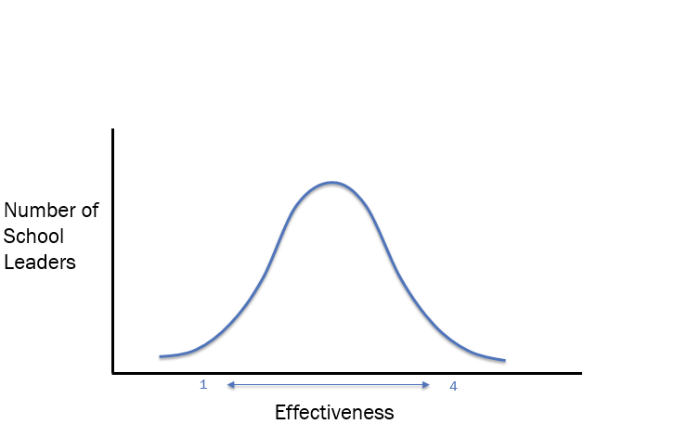
Principal Evaluation: A Tool For Improving Leadership (slide 1 of 2)

Slide 44
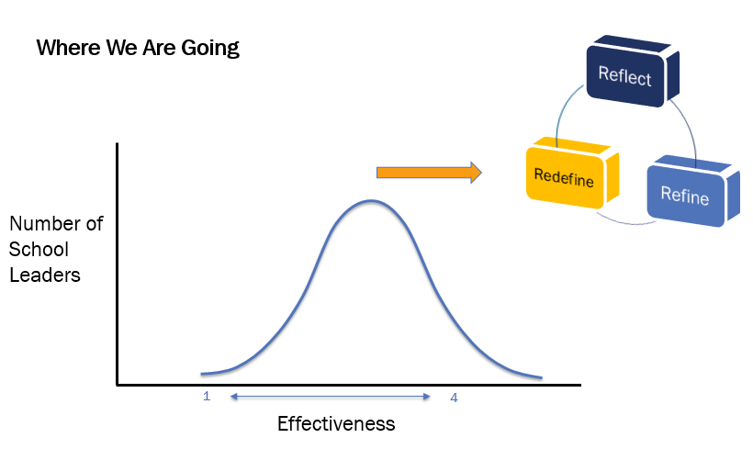
Principal Evaluation: A Tool For Improving Leadership (slide 2 of 2)

Slide 45
School Leader Evaluation In Two New Jersey Districts 2015-16
Districts 1 and 2 are large urban districts with similar student growth scores
What might be some of the reasons for the difference in these charts?

Slide 46
2015-16 School Leader Practice Scores Vs Teacher Practice Scores
What is the difference between teacher and principal practice ratings?
What might explain this difference?

Slide 47
Principal Evaluation Challenges
8% school leaders did not receive a summative score in 2015-16
Only 38 principals/APs/VPs were identified as needing extra support in 2015-16
School leader evaluation has taken a backseat to other priorities, including teacher evaluation
District leader turnover is high (~100 annually) making evaluation quality and consistency for principals challenging to maintain
The work of the principal is inherently different from that of the teacher but observation processes may not reflect this
Administrator goals do not necessarily align with district priorities or reflect how a principal creates change in a school

Slide 48
3 Rs to Strengthen Leadership Through Evaluation
A planning conference
initiates the evaluation cycle
Reflect
Refine
Redefine
Observations become a collection of evidence over time
Administrator goal focus extends over multiple years and aligns to school/district priorities

Slide 49
Looking For The Right Things Using The Standards
Leadership Practices
Teaching and Learning
Student Achievement
Other Student Outcomes
School Community
Other School Outcomes
Ex. PARCC, AP/IB, Benchmarks
Ex. Chronic absenteeism, course enrollment, grad rates
Ex. Climate and culture, higher ed partnerships, family engagement
Revised Professional Standards for Educational Leaders* emphasize the following:
Student learning
Human relationships
Instructional leadership
Distributed leadership
*Professional Standards for Educational Leaders (PSEL) were adopted by New Jersey in March 2017
Analysis of ISLLC and PSEL - http://www.nasbe.org/wp-content/uploads/Prociw_Leader-Stds-Final.pdf

Slide 50
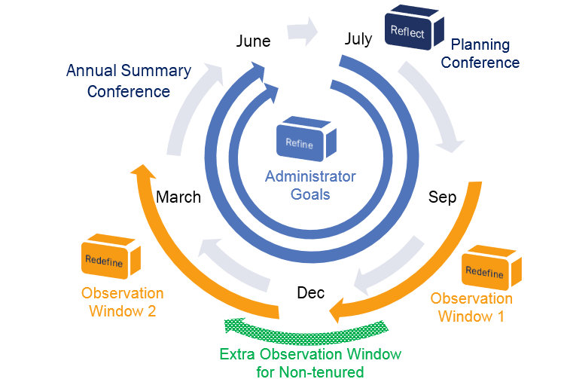
Stages Of The Evaluation Cycle
SGO average and mSGPs (for those who qualify) are also included in the final evaluation score of school leaders. The Evaluation Leadership Instrument, now optional, may also be used for evaluation.

Slide 51
Evaluation Cycle Timeline And Activities
http://www.state.nj.us/education/AchieveNJ/resources/UsingPrincipalEvaluationtoImproveSchoolLeaderEffectiveness.pdf

Slide 52
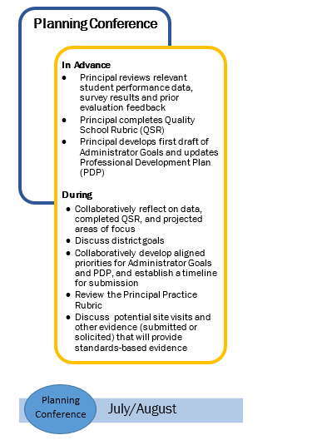
Begin With An Annual Planning Conference
Reflect
Why
Builds a collaborative foundation
Develops a shared understanding of district/school/professional goals
Clarifies evaluation process expectations
What
Discuss student and school data and develop areas of focus
Align priorities for Admin Goals and PDP
Identify priority standards on practice rubric aligned to goals
Determine potential sources of evidence

Slide 53
Rowing Together In The Right Direction
Refine
*A Harris Poll of 23,000 U.S. residents employed full time within key industries and in key functional areas shows:
If this were a basketball team:
37 percent have a clear understanding of what their organization is trying to achieve and why.
1 in 5 was enthusiastic about their team’s and organization’s goals.
Only 15 percent felt that their organization fully enables them to execute key goals.
Only 15 percent felt they worked in a high-trust environment.
Only 2 or 3 players would know which basket was their own…
…and only 1 would care
Only one or two would know what position they play in and know exactly what they are supposed to do
Four players would, in some way, be competing against their own team rather than the opponent.
*Adapted from “The 8th Habit: From Effectiveness to Greatness” by Steven Covey

Slide 54
Administrator And Other Goals
Refine
As shown by the previous example, having clear, and aligned goals is important for success in complex organizations.
However, school districts often suffer from having too many goals, many of which may not be aligned or communicated throughout the organization
Administrator
Goals
District
PDP
District Improvement
School Board
Superintendent Merit
School Improvement
SGOs

Slide 55
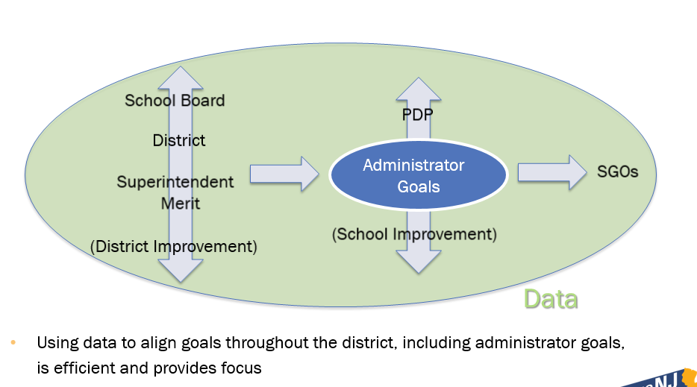
Align Administrator Goals
Refine

Slide 56
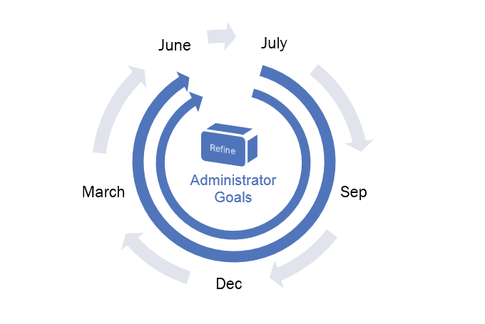
Align Administrator Goals
Refine

Slide 57
Align Administrator Goals
Refine
District experiencing rapidly changing demographics
ELL students at Mountainside Middle School (MMS) show below average growth in math.
Year 1 Goal
MMS will show considerable improvement in the delivery of math instruction to ELL students by the end of school year 2017-18, as measured by an increase in the average of teacher satisfaction on the end-of-year survey to 3.8 /5.
Baseline score: 2.3/5
Action steps: PD for teachers, improved scheduling, updated curriculum
Year 2 Goal
43 percent of ELL students at MMS will meet or exceed their target scores on the EOY math assessment with targets to be set by the district benchmark testing for SY 2017-18.
Baseline score: 35% of ELL students met targets (an average of the past two years, up 4% from the prior year).
Action steps Improved process in data tracking and intervention.

Slide 58
O Observations: A Collection of Evidence Over Time
Redefine
Observation 1
Observation 2
From discrete observations
To collecting a portfolio of evidence
Planning Conference
Observation Conference
Annual Conference
Observation Window 1
Observation Window 2
Additional window for non-tenured
Turn and Talk: What evidence would lead to actionable feedback?

Slide 59
Observations: A Collection of Evidence Over Time
Redefine
Four types of evidence
Direct Observation: the principal is present and leading
e.g. a post-observation conference, instructional rounds, hiring interview, a faculty meeting
Indirect Observation: the principal is not present and his or her effect is being seen indirectly
e.g. a data meeting led by a teacher leader, or stakeholder feedback on a survey, testimony of staff and students
Artifacts: a record of the principal’s work
e.g. blog, tweet, agenda, PowerPoint from principal-led PD, parent letters
Student Data
e.g. PARCC and benchmark testing results

Slide 60
Thank You! From Paul Palek
Next Steps: Identify one area of principal evaluation that your district might choose to prioritize
Reflect through a Planning Conference
Refine Administrator Goals
Redefine Observations
Reflect
Refine
Redefine
Contact Information:
Paul Palek
Implementation Manager
paul.palek@doe.state.nj.us
Office of Evaluation
educatorevaluation@doe.state.nj.us
(609) 376-3974
Website and Resources
AchieveNJ
Principal Evaluation Guidance
Administrator Goals

Slide 61
Elevating, Supporting and Retaining Highly Effective Teachers
Office of Evaluation
Division of Teacher and Leader Effectiveness
Summer 2017

Slide 62
Agenda
In this session, we will discuss ways to elevate, support, and retain Highly Effective teachers
Why it’s critical, and
How we can do it more intentionally
Elevate
Support
Retain
Highly Effective Teachers

Slide 63
Research Says: Teachers Matter Most
Teachers matter more to student achievement than any other aspect of schooling.
Teachers have two to three times the impact of any other school factor, including services, facilities, and even leadership.*
RAND Corporation (2012). Teachers matter: Understanding teachers' impact on student
achievement. Santa Monica, CA: http://www.rand.org/pubs/corporate_pubs/CP693z1-2012-09.html.

Slide 64
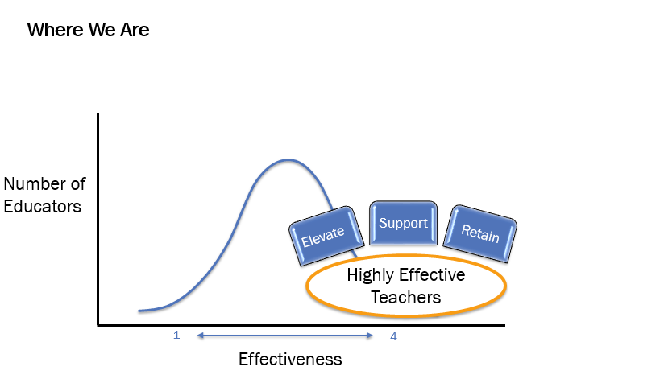
Teacher Evaluation: A Tool for Improving Our Best Teachers

Slide 65
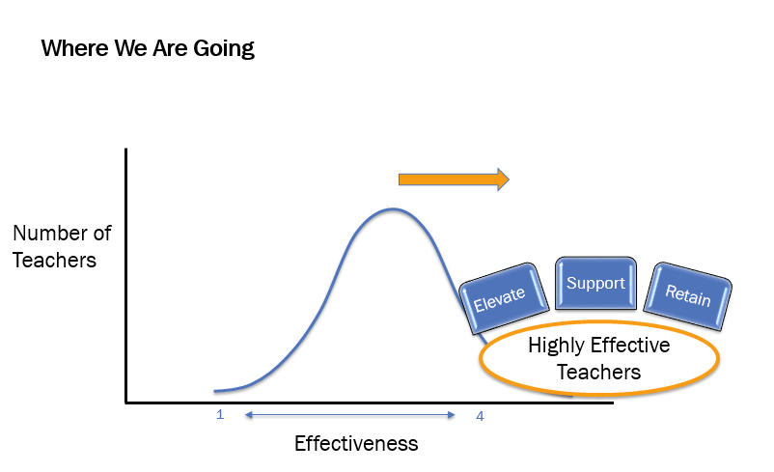
Teacher Evaluation: A Tool for Improving Our Best Teachers

Slide 66
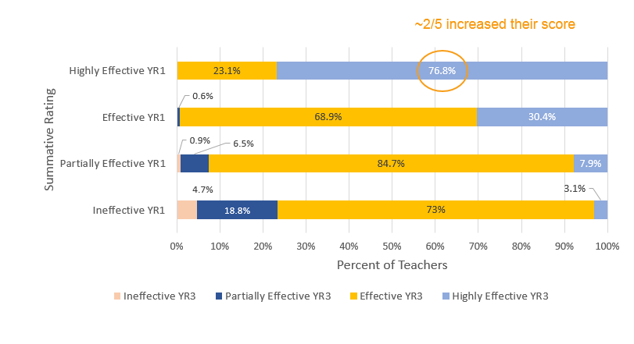
Are Our Best Getting Better?

Slide 67
Elevating Our Best
Achievement Coaches are one example of how districts are using the evaluation system to identify and leverage their best teachers.
Elevate
Support
Retain
Highly Effective Teachers

Slide 68
Better Outcomes For More Students
Given the right conditions, these teachers can improve the practice of their colleagues…
… which can lead to better outcomes for more kids.

Slide 69
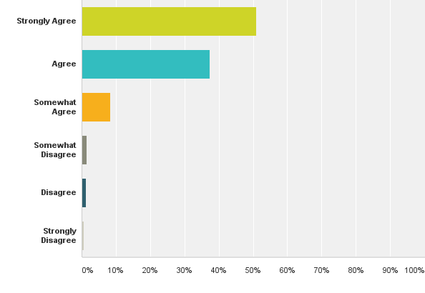
Achievement Coach Districts & Impact
Districts
Bergenfield Boro | Mantua Township
Caldwell-West Caldwell | Maurice River Township
Clearview Regional | Metuchen
Delsea Regional | Morris County Voc. Tech
East Brunswick | North Plainfield Borough
East Greenwich Township | Old Bridge Township
Elizabeth | Palisades Park
Gloucester Township | Passaic City
Hopatcong | Piscataway Township
Jackson Township | Princeton
Jersey City | Sayreville
Lacey Township | Scotch Plains-Fanwood
Little Egg Harbor Township | South River
 | Watchung Hills Regional
“The Achievement Coaches working with me helped facilitate my learning in an effective way.”
http://www.state.nj.us/education/AchieveNJ/achievementcoaches/

Slide 70
Supporting Our Best
Elevate
Support
Retain
Highly Effective Teachers
Great Teachers
Administrators
Reflective Practice Protocol
Seek to grow their practice
Crave effective feedback
Help teachers grow by promoting self-reflection in evaluation
A viable option for evaluating Highly Effective teachers to support their continued growth

Slide 71
Best Practices
ACTIVITY: With a partner, discuss how a great teacher has used one or more of the areas below to develop his/her practice or the practice of a colleague in order to deliver better, more responsive instruction to students. Which has had the most significant impact?
Student Feedback
Student Assessment
Classroom Video
Evaluation Observation

Slide 72
Reflective Practice Protocol
Summative Rating
Teacher Practice
Traditional Classroom Observation(s)
Reflective Conference
Student Achievement
SGO/mSGP
Video Lesson Capture Reflection
Student Voice Reflection
Traditional Classroom Observation Reflection
Student Assessment Reflection
http://www.state.nj.us/education/AchieveNJ/teacher/

Slide 73
Autonomy & Flexibility for Districts and Teachers
Reflective Conference
Video Reflection
Assessment Reflection
Observation Reflection
Student Voice Reflection
Autonomy to define accomplishment and timing of the Reflective Conference.
Flexibility to emphasize areas that best support the teacher’s focus.
Additional options
Cooperating Teachers
Teachers Pursuing National Board Certification.
http://www.nj.gov/education/AchieveNJ/teacher/ReflectivePracticeRationale.pdf

Slide 74
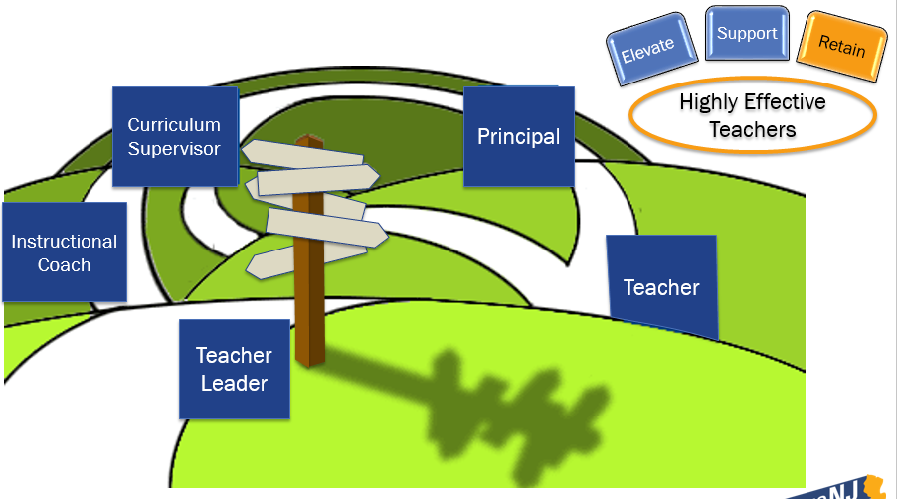
Retaining Our Best

Slide 75
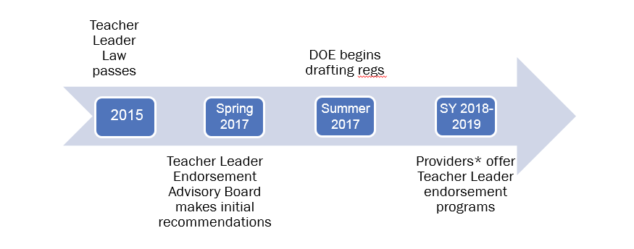
Teacher Leader Endorsement
*Program Providers
Institutes of Higher Education, Education Organizations, Non-Profit Entities, or a combination
www.njea.org/teacher-leader-endorsements-moves-njdoe

Slide 76
Districts as Program Providers
Why
Build a cohort of teacher leaders to enhance culture and instructional practices
Invest in local talent and create a homegrown leadership pipeline
Retain the best teachers by offering new growth opportunities
How
Develop an endorsement program to suit the needs of the district and its teachers
Provide the program as professional development alternative to enrollees
Sustain program by offering program at a cost to other districts

Slide 77
Benefits Of The Teacher Leader Endorsement
Teacher Concern | Response
I am already a teacher leader; I don’t need an endorsement | Training can hone existing leadership skills, and build additional areas of expertise.
I am too busy to enroll in an endorsement program | When the program takes place locally, it reduces travel time and costs; it can replace other PD requirements
I would rather pay money for a supervisor’s certificate. | Unlike a supervisor’s certificate, the teacher leader endorsement earned through a district has minimal cost.

Slide 78
Thank You! From Chelsea Collins
Next Steps: Identify one strategy related to Highly Effective teachers that you are considering for your district
Elevate: Achievement Coaches Model
Support: Reflective Practice Protocol
Retain: Teacher Leader Endorsement
Elevate
Support
Retain
Highly Effective Teachers
Contact Information:
Chelsea Collins
Policy Manager for Accomplished Teaching and Teacher Leadership
Chelsea.Collins@doe.state.nj.us
Office of Evaluation
educatorevaluation@doe.state.nj.us
(609) 376-3974
Website and Resources
AchieveNJ
Achievement Coaches
Reflective Practice Protocol
Teacher Leader Report

