Slide 1
EFFECTIVE ASSESSMENTS

Slide 2
Session Objectives
Apply concepts from today’s presentation in planning concrete next steps towards…
determining the purpose of assessments in monitoring student learning.
creating true value in assessing students by properly integrating them into the teaching and learning cycle.
incorporating the five elements of assessment design in creating balanced and well-designed assessment items which accurately measure what students know and can do.

Slide 3
Agenda
INTRODUCTION
DETERMINING THE PURPOSE OF AN ASSESSMENT IMPLEMENTING VALUABLE ASSESSMENT PRACTICES DESIGNING ACCURATE ASSESSMENTS

Slide 4
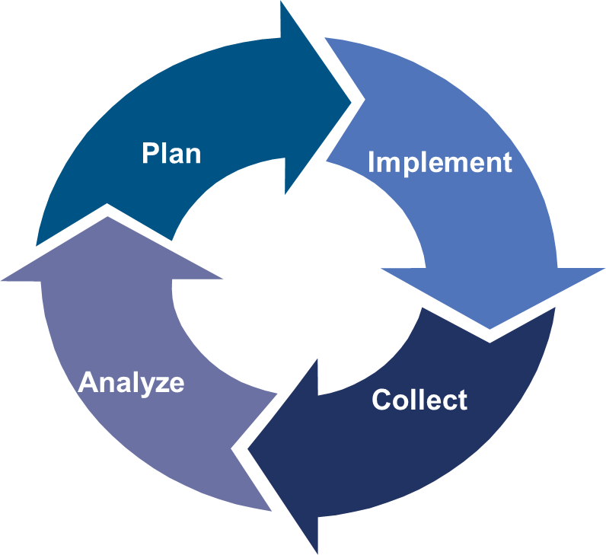
Monitoring and Adjusting in the Teaching and Learning Cycle
Fostering Intellectual Engagement
Using Assessment Data to Drive Instruction
Effective Assessments

Slide 5
Assessments and the Learning Process
Testing: Dipstick versus Learning Tool
Make it Stick
“There are few surer ways to raise the hackles of many students and educators than talking about testing. The growing focus over recent years on standardized assessment, in particular, has turned testing into a lightning rod for frustration over how to achieve the country's education goals . . . But if we stop thinking of testing as a dipstick to measure learning-if we think of it as practicing retrieval of learning from memory rather than “testing,” we open ourselves to another possibility: the use of testing as a tool for learning.”
(Brown, Roediger, & McDaniel, 2014)

Slide 6
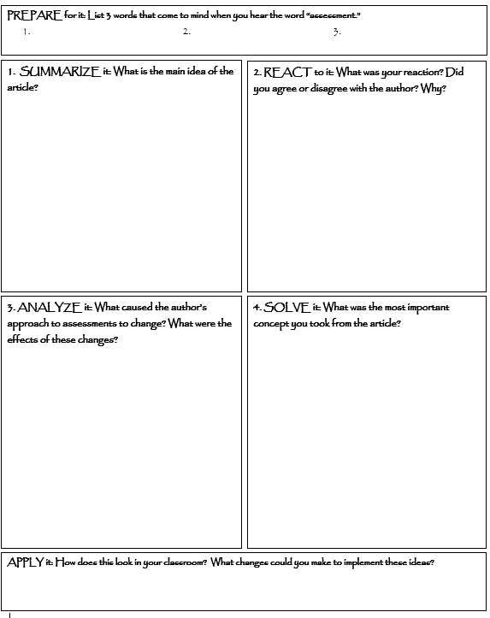
“Learning to Love Assessment”
Read the first page of the article and your assigned understandings.
Complete Boxes 1-4 in the graphic organizer
Discuss your responses with your group members
Determine a spokesperson for your group
Share out
Apply

Slide 7
Where do Assessments Belong in the Teaching and Learning Cycle?
What should my students learn by when?
What activities will help ensure they learn this?
How will I ensure they learn it?
How will I know they have learned it?
What tool will I use to collect information about student learning?
Notes:
Discuss this in the frame of assessments driving the learning in the classroom.
Assessments are involved in all areas of the teaching learning cycle.
Assessments need to be appropriately planned.
Assessments are implemented in lessons.
Assessments are evaluated/graded.
The information from the assessments is analyzed.

Slide 8
Effective Assessments
Purpose
Assessments are opportunities to learn what our students know and need.
Value
Accuracy
Transparent assessment practices are valuable to both teachers and students.
Valid assessments are balanced and well designed.

Slide 9
Agenda
INTRODUCTION
DETERMINING THE PURPOSE OF AN ASSESSMENT
IMPLEMENTING VALUABLE ASSESSMENT PRACTICES DESIGNING ACCURATE ASSESSMENTS
Notes:
Mention here that these three parts equal
Purpose: Determine the purpose
Value: Effective practices
Accuracy: by paying attention to the five elements

Slide 10
The Purposes of Assessment
Think about ways you currently assess student learning throughout a unit of study.
Take one minute to write down as many as you can on separate post-its

Slide 11
The Purposes of Assessment
Diagnostic Assessment: Used to determine students’ knowledge and skills before a unit of instruction.
Formative Assessment: Used to monitor student learning and adjust ongoing instruction.
Interim Assessment: Measure students’ knowledge and skills on a specific set of academic goals, typically within a particular time frame.
Summative Assessment: Measure student mastery of standards at the end of a unit of instruction.
Diagnostic Assessment
Formative Assessment
Interim Assessment
Summative Assessment
The Purposes of Assessment

Slide 12
The Purposes of Assessment Activity
Return to post-its.
Sort assessments into purposes
2. Reflect:
Could you have sorted them differently? How and why?
Notes:
(animate on mouse click)
Activity:
Count off, put coaches in groups
Groups go to designated area in room (numbers posted on walls before session starts). Poster of 4 purposes at each wall.
Part 1: Coaches sort together and add additional strategies
Debrief on slide 17

Slide 13
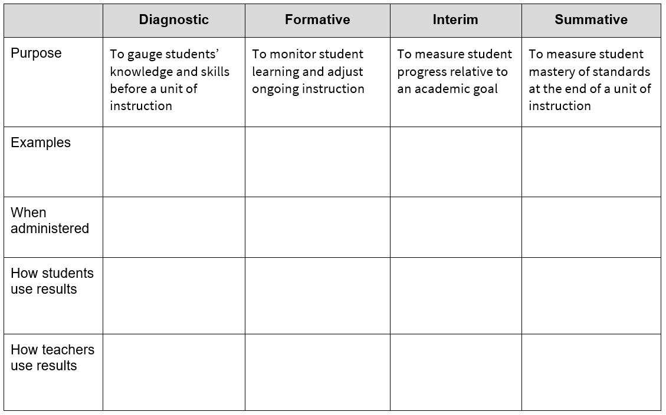
Practice: Determining the Purpose

Slide 14
Check for Understanding
Using the posters around the room, and table you created, respond to this question using the handout provided:
What are the purposes of assessment?

Slide 15
Key Takeaways
Assessment is a tool for learning when used
to determine what students know
to determine what students need to know
to determine what students learned
to plan instruction
to help students gauge their progress

Slide 16
Agenda
INTRODUCTION
DETERMINING THE PURPOSE OF AN ASSESSMENT
IMPLEMENTING VALUABLE ASSESSMENT PRACTICES
DESIGNING ACCURATE ASSESSMENTS

Slide 17
Implementing Valuable Assessment Practices
Assessment practices which
create student ownership of learning include:
Incorporating a variety of assessment approaches.
Continuously providing task- involving feedback.
Creating opportunities for productive struggle.
Developing and utilizing common assessments when practical.

Slide 18
Teaching and Learning Cycle
A process by which teachers…
Plan – Develop curriculum, instruction, and assessments
Implement – Teach
Collect – Gather indicators of student progress
Analyze – Identify trends, patterns, and misconceptions; decide what needs more reinforcement or re-teaching
Plan – Refine the plan based on analysis of the data
Notes:
Introduce Olympics Example

Slide 19
Let’s Learn about the Olympics
Notes:
Will share plan at May 24 meeting. Slides (and lesson plan) to be added once finalized.

Slide 20
We’re off to the Olympics!

Slide 21
What do we Know?
1.Kahoot.it
2. Type in game pin #
3. Type your first name and first letter of your last name

Slide 22
Objectives
Describe places of interest in Rio De Janeiro.
Identify current political issues and how they are impacting the games.
Identify current headlines and how they are impacting people’s interest in the games.

Slide 23
Z
Z Chart
Title
The “gist” of your topic
Three important ideas associated with your topic
1.
2.
3.
Picture representation(s) of your topic
Why is this important?

Slide 24
With Your Group...
Research
Complete “Z” Chart
Plan Presentation
Practice and Critique
Refine

Slide 25
Graphic Organizer
Geography
Politics
Headlines
Impact
Questions

Slide 26
Here we go!
presentation
gallery walk
assessment

Slide 27
Show us what you know!
Write a one minute essay on what you’ve learned. Be sure to include how the politics, places of interest and headlines are impacting the games.

Slide 28
Monitoring and Adjusting Instruction
Plan
Diagnostic Assessment
Quizzes, formulated items used for baseline or pre-tests
Formative Assessment
Quizzes, checks for understanding, exit tickets
Implement
Summative Assessment
State tests, portfolios, SGOs, benchmarks, mid-terms, final assessments
Interim Assessment
District-wide benchmarks, unit assessments
Collect
Analyze

Slide 29
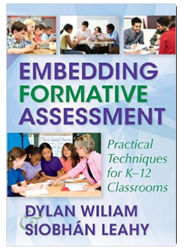
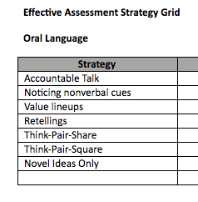
Incorporate a Variety of Approaches
Review the Effective Assessment Strategy Grid
Indicate one new strategy you would like to use and explain how you would use it in your classroom.
Resources we love for assessment strategies!

Slide 30
Provide Valuable Feedback
Notes:
https://www.youtube.com/watch?v=NWv1VdDeoRY

Slide 31
Feedback Activity
Feedback Should Be More Work For The Recipient Than The Donor
Focus on the reaction of the students, not the feedback.
Develop a growth mindset in your students.
Design feedback as part of a system.
Focus more on longer time for feedback.
Concentrate on personal bests, not efforts or ranks.
Make feedback into detective work.
Provide comment-only grading.
Use focused feedback.

Slide 32
Provide Valuable Feedback
The Praise Makeover
Before | After
“Great Job!” | “I like the way you tried all kinds of strategies on this problem until you finally got it.”
“I’m proud of you” | “You went back to check your work – that extra step was a great idea.”
“You got an A!” | “Those extra problems you did really made a difference.”
“You’re so smart” | “It was a long, hard assignment, but you stuck to it and got it done. That’s great!”
“Don’t worry, some people just aren’t good at math” | “I like the effort you put in on this. I know you’re frustrated, but we’ll keep at it and find your best way to master this.”

Slide 33
Productive Struggle Leads to Success
Notes:
As adults we recognize this but our students may not realize it.

Slide 34
Create Opportunities for Productive Struggle
What is the teacher doing?
What are the students doing?
What else do you notice? (materials, resources, use of space and time, etc.)
Productive Struggle in the Classroom

Slide 35
Productive Struggle Leads
to Student Ownership
Active learning methods such as self-quizzing, elaboration, and reflection cause students to:
Reconsolidate memory
Create mental models
Broaden mastery
Foster conceptual learning
Improve versatility
Prime the mind for learning
Notes:
These terms come from pages 82-86 of “Make it Stick.”

Slide 36
Common Assessments
Common assessments help to:
provide guidance to drive instruction in more focused way
provide consistency within departments
show students that they are being held to high expectations/standards
consolidate learning by bringing it all together
Notes:
Tie to using assessment data to drive instruction

Slide 37
Check for Understanding
Which assessment practice is your area of strength and which is your area for growth?
Variety
Feedback
Productive Struggle
Common Assessments

Slide 38
Key Takeaways
Assessment practices which
create student ownership of learning include:
Incorporating a variety of assessment approaches.
Continuously providing task-involving feedback.
Creating opportunities for productive struggle.
Developing and utilizing common assessments when practical.

Slide 39
Agenda
INTRODUCTION
DETERMINING THE PURPOSE OF AN ASSESSMENT
IMPLEMENTING VALUABLE ASSESSMENT PRACTICES
DESIGNING ACCURATE ASSESSMENTS

Slide 40
The Assessment Design Modules
4 parts divided into 13 modules:
Part I: Key Concepts
Part II: Five Elements of Assessment Design
Part III: Writing & Selecting Assessments
Part IV: Reflecting on Assessment Design
Notes:
Good place to introduce the Assessment Design modules and accompanying checklist and blueprint.
The graphic is hotlinked.
Activity: Distribute Assessment Design Checklist and discuss using Notice and Wonder
Assessment Design Toolkit link (with all of the resources) http://www.csai-online.org/spotlight/assessment-design-toolkit

Slide 41
Assessment Design Checklist
Notes:
Notice and Wonder--Graphic Organizer in binder (complete first two boxes)

Slide 42
The Assessment Design Blueprint
Notes:
As a team, would want to use this to create a common assessment.

Slide 43
Elements of Assessment Design: Alignment
An assessment aligned with standards measures student performance on those standards.
Notes:
Model one for them and then bring standards. Provide a list.

Slide 44
Alignment: Unpacking the Standard
Does each assessment item align with the standard you intend to teach and measure?
Read the Standard.
Compare and contrast treatments of the same topic, or of various perspectives, in several primary and secondary sources; analyze how they relate in terms of themes and significant historical concepts.
Identify and clarify meanings of terminology used within the standard.
RH.9-10.9: Compare and contrast treatments of the same topic, or of various perspectives, in several primary and secondary sources; analyze how they relate in terms of themes and significant historical concepts.
Nouns = content necessary, while verbs = what students need to do.
Verbs = compare, contrast, analyze, relate
Nouns = treatments, “same topic,” “several sources” primary, and secondary, themes, significant historical concepts
Notes:
**Add animation for each step
We should model one and then break them into groups to have them work on unpacking one standard from their discipline (We can provide some examples from various disciplines just in case). If they are told to be prepared, possibly each bringing their own standards with them would help? You could also reference Course 2, Conversation 1 from the Blended Online Learning Modules WIll put this in the resources.
Does each assessment item align with the standard you intend to teach and measure?
Read the Standard.
Identify and clarify meanings of terminology used within the standard.
Nouns = content necessary, while verbs = what students need to do.

Slide 45
Alignment: Determine the Skills and Assessment
Determine skills necessary for students to fully demonstrate understanding of standards.
Summarizing articles; Compare and contrast over multiple sources; Differentiate primary and secondary sources; Recognize point of view/bias
Discuss rationale for each skill.
Identify formative, diagnostic, interim and summative assessment strategies that could be used to assess this standard.
Non-content related articles to compare and contrast (high interest)
Close reading activity, Station activity (analyzing documents from different sources/points of view: Abolition of Slavery, Gettysburg Address, New York Times article, Closure with question about each of the statements)
Unit test (open ended question)
Timed Document Based Question
Research Paper

Slide 46
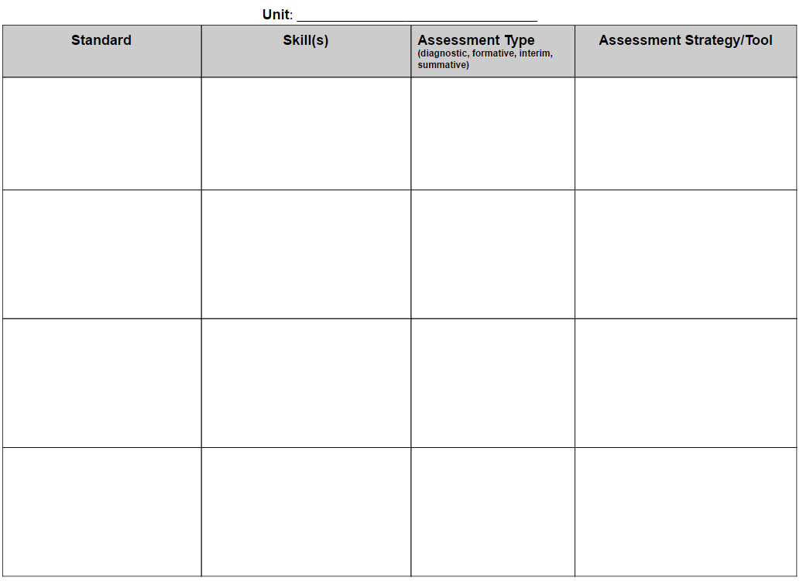
Alignment: Determine the Skills and Assessment
Notes:
Standards: https://docs.google.com/document/d/1BJWDAQ7d5wsD3PVexj4g8sYA1leXIz9x0M1EcyhuVas/edit?usp=sharing
Group Activity:
Unpack the Standard
Determine the skills
Plan the assessment types
In Groups:
Read the Standard
Identify and clarify meanings of terminology used within the standard.
Nouns = content necessary, while verbs = what students need to do.
Determine skills necessary for students to fully demonstrate understanding of standards
Discuss rationale for each skill
***Use Assessment Design Blueprint*** Good application

Slide 47
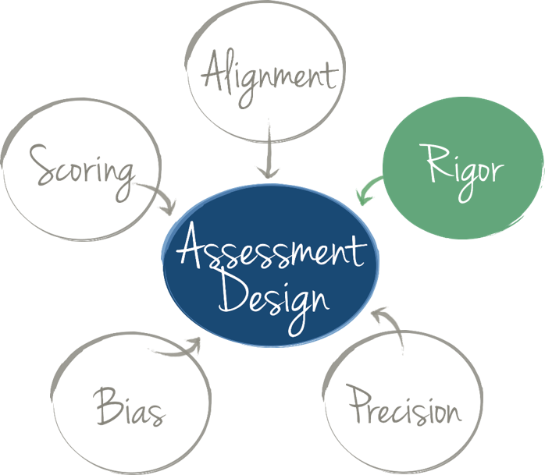
Elements of Assessment Design: Rigor
An assessment has “an appropriate level of rigor” if…
It includes items that match the level of rigor of the skill or skills you intend to measure.
It measures a range of student thinking and understanding so that it can determine what all students know and can do.

Slide 48
Understanding Rigor
Range of Rigor/Depth of Knowledge
Why does it matter?
What does it look like? | The assessment requires a range of thinking skills as proposed by Webb’s Depth of Knowledge (DOK) that reflects the rigor of the course.
An assessment that accurately reflects the range of rigor of the course and instruction increases the validity of inferences educators can make about student learning.
Provides access points to students of varying ability.
Notes:
Leave right column blank, ask participants to discuss, then debrief...use animation

Slide 49
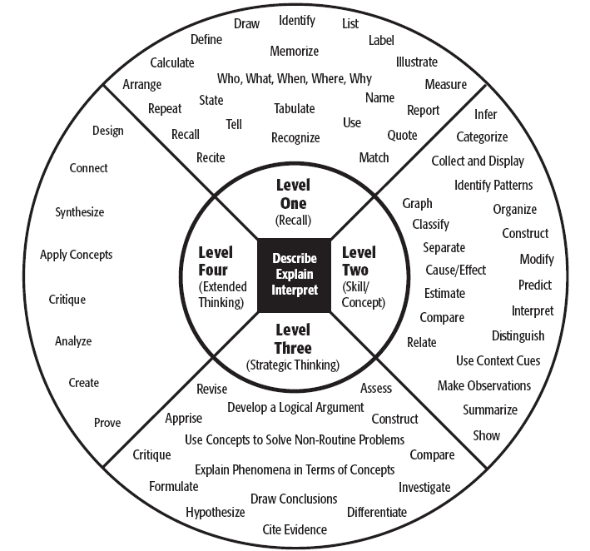
Identifying Level(s) of Rigor
Depth of Knowledge Wheel (DOK)
Notes:
An explanation of DOK is needed here to introduce this.

Slide 50
Practice: Identifying the Level of Rigor
Understanding Levels of Thinking
Activity: Turn and Talk
Work with a neighbor to explain which level of the DOK wheel each activity represents and why it fits that level.
Choose two insects that you have observed and compare them.
Level 2: Basic Skills and Concepts
Name a food group.
Level 1: Recall and Reproduction
Create an in-depth character analysis, including textual and historical support for choices and perform said character.
Level 4: Extend Thinking
Identify two examples when a fork would not be the right utensil to use and explain why.
Level 3: Strategic Thinking and Reasoning
Notes:
This think-pair-share activity was used successfully during our SGO 2.1 presentations to highlight the levels.
Extension activity: Ask Ts to compile list of what assessment for each activity could look like in a classroom.

Slide 51
Rigor and Questioning Research
How does high quality questioning promote learning?
Stimulate thinking
Clarify understanding
Reveal misconceptions
Deepen understanding
Hear alternate views
Make connections
Notes:
Include the Q chart in handouts
The level of rigor comes from the questions we ask..
Stress that this is the natural progression - you unpack the standard, determine the level of rigor, and then write assessment items (i.e. question) that match that level of rigor (the Q chart is very helpful for this)

Slide 52
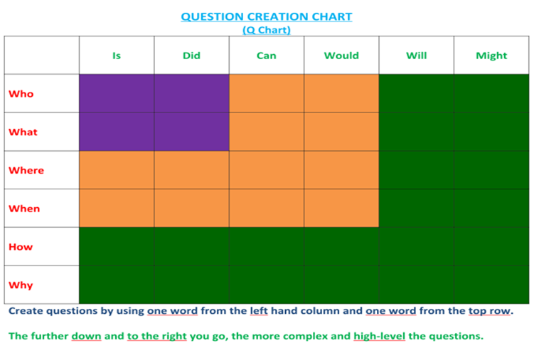
Rigor and Questioning
Notes:
Include the Q chart in handouts
The level of rigor comes from the questions we ask..
Stress that this is the natural progression - you unpack the standard, determine the level of rigor, and then write assessment items (i.e. question) that match that level of rigor (the Q chart is very helpful for this)

Slide 53
Rigor and Questioning
Does each assessment item align with the standard you intend to teach and measure? Does the assessment item reflect the appropriate level of rigor?
RH.9-10.9: Compare and contrast treatments of the same topic, or of various perspectives, in several primary and secondary sources; analyze how they relate in terms of themes and significant historical concepts.
What is the main disagreement between the two authors?
What would author X say in response to author Y?
Why might these two authors have different views on the same topic?
Notes:
Model the questioning activity here using the model standard (RH.9-10.9)
1 from purple, 1 from orange, 1 from green (on Q chart)
Underlined question stems here in order to highlight connection to Q chart

Slide 54
Rigor and Questioning Activity
Group Activity:
Working in your small group, create 3 - 4 questions you could use to assess the standard you unpacked on the Alignment Tool.
Questions should represent a range of rigor.
Use the Q Chart and the Depth Knowledge Wheel to help with this.

Slide 55
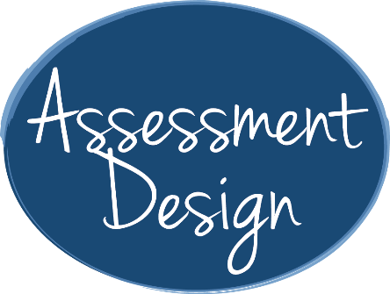
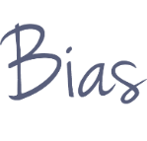
Elements of Assessment Design: Precision
A precise assessment measures students’ knowledge and skills, not their misinterpretations or lack of unrelated background knowledge.
Notes:
The next three element descriptions and activities come pretty directly from the Assessment Design modules. The information needs to be consistent.

Slide 56
Key Concepts in Precision
Well-designed assessments…
are formatted in a logical order
do NOT contain typos or factual errors
contain accurate and clear instructions
include all of the information students need to demonstrate their knowledge and skills

Slide 57
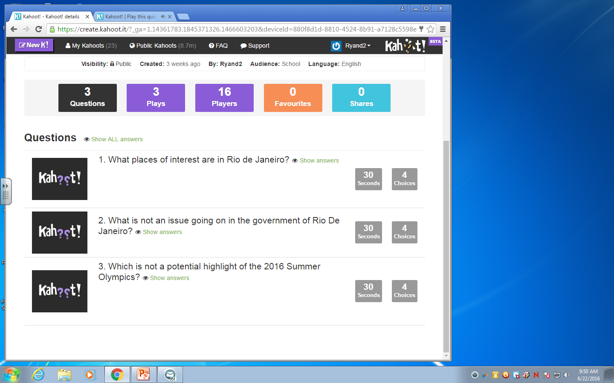
Key Concepts in Precision

Slide 58
How could this item be constructed to be made more precise?
Marcus has 34 marbles. He puts an equal number of marbles into four bags. For 1a–1d, choose Yes or No to indicate whether each number sentence could be used to find the number of marbles that Marcus puts in each bag.
36 x 4 =
36 ÷ 4 =
36 x = 36
36 ÷ = 36
Notes:
Activity: How could you revise this item to make it clearer?
Marcus has 34 marbles. He puts an equal number of marbles into 4 bags. For “1a”–“1d,” choose Yes or No to indicate whether each number sentence could be used to find the number of marbles that Marcus puts in each bag.
a. 36 x 4 =
b. 36 ÷ 4 =
c. 36 x [blank] = 36
d. 36 ÷ [blank] = 36

Slide 59
How could this item be constructed to be made more precise?
Marcus has 34 marbles. He puts an equal number of marbles into four bags. For 1a–1d, choose Yes or No to indicate whether each number sentence could be used to find the number of marbles that Marcus puts in each bag.
36 x 4 =
36 ÷ 4 =
36 x = 36
36 ÷ = 36
Notes:
Activity: The first sentence contains a typo; that is, it reads 34 marbles instead of 36. The prompt references choices 1a–1d, but the answer choices do not include the number “1,” which may cause confusion. The choices also do not make clear where they are missing information; that is, choices “a” and “b” are missing information after the equal sign, and choices “c” and “d” are missing information before the equal sign.

Slide 60
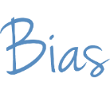
Elements of Assessment Design: Bias
An unbiased assessment
measure students’ knowledge and skills
do not measure differences
amongst students because
of their personal characteristics
Notes:
Option: Presenters can use the two samples of bias from RSN one-pager (provide handout):
Conjunctions and Quarterback Sacks
Probability and Deck of Cards
“Bias” should be written in the bubble Same as precision.

Slide 61
Is this an Example of Bias?
Which of the following measures could be the length of a typical hole in a golf course?
300 inches
300 feet
300 yards
300 miles
Notes:
Activity: Consider this assessment item.
Which of the following measures could be the length of a typical hole in a golf course?
300 inches;
300 feet;
300 yards; or
300 miles
Do you think this item may be biased? Why or why not?

Slide 62
Is this an Example of Bias?
Which of the following measures could be the length of a typical hole in a golf course?
300 inches
300 feet
300 yards
300 miles
Familiarity with Golf
What is the source of bias?
Measurement Units
Socioeconomic Status
Notes:
Activity: This item is similar to the example we just discussed. Typically, golf is an expensive activity. The item may provide an advantage to students who come from more affluent backgrounds and are thus more familiar with the sport of golf.

Slide 63
Detecting Bias
Remember, bias does not mean that assessment items cannot include any references to topics that may interest some groups of students and not others. That would make designing assessments nearly impossible.
It’s difficult to detect your own bias.

Slide 64
Precision and Bias Activity
Go back to the questions you created in the previous activity. Trade.
Evaluate each question for precision and bias.
Were any of the questions biased in any way?
How could they be improved?
Notes:
Provide additional examples to evaluate.

Slide 65
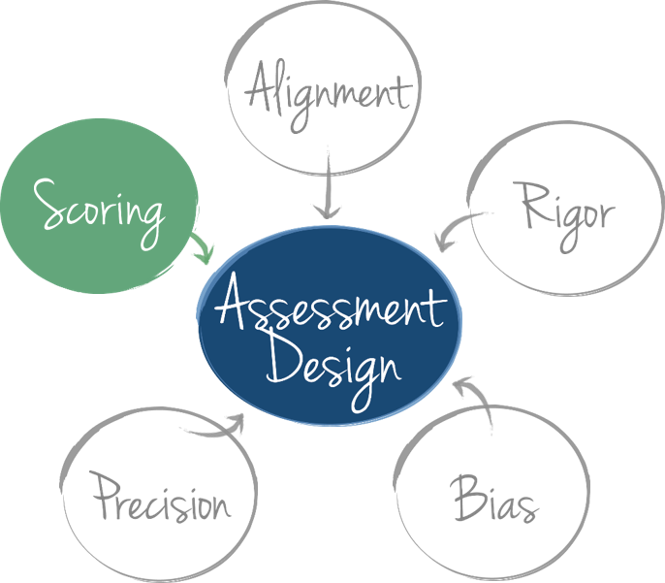
Elements of Assessment Design: Scoring
An assessment that has an appropriate scoring strategy measures students’ knowledge and skills, not how the assessment is scored or who scores it.

Slide 66
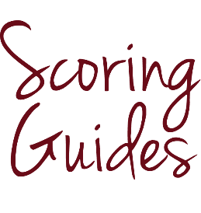
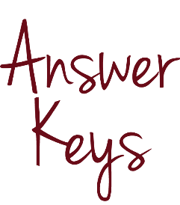
Effective Scoring Methods Include…
Notes:
Groups will talk about their own definitions of each of these terms.

Slide 67
Scoring Options
Notes:
You may score an assessment yourself, with another teacher or with a team of teachers.

Slide 68
Scoring Options
Go back to the list of assessment strategies you created earlier.
Choose one and decide the best possible scoring option. Be prepared to explain why you chose this scoring option.
How could another scoring option change the data?
Notes:
Debrief: participants share with whole group as time allows

Slide 69
Check for Understanding
Notes:
Participants return to Notice and Wonder handout and complete final box

Slide 70
Key Takeaways
Assessments should
align to standards.
match the level of rigor of the standard and include a range of rigor.
be constructed with precision.
be checked for bias.
utilize an appropriate scoring method.

Slide 71
Monitoring and Adjusting in the Teaching and Learning Cycle
Fostering Intellectual Engagement
Using Assessment Data to Drive Instruction
Effective Assessments

Slide 72
Tying it all Together
If you were riding in an elevator with your superintendent, a parent, a student and a colleague, and they asked you about the assessment cycle, what would you say? Write your one-minute explanation.

Slide 73
Closure
5 R’s of Reflecting
•Restate: What did you learn?
•React: What is your opinion?
•Relate: How does it relate to you?
•Respond: With a question.
•Realize: Why is it important?
Notes:
Institute reflection on whole module. Introduce as alternate to Elevator Speech

Slide 74
Closure
Specific
Measurable
Action-Oriented
Realistic
Time-bound
Set a SMART Goal
for your practice

Slide 75
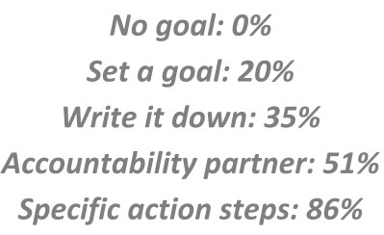
Closure
Now that you’ve set a goal,
make it stick!
Notes:
From Pete Hall, Lead On

