Slide 1
USING ASSESSMENT DATA TO DRIVE INSTRUCTION

Slide 2
WE ALL USE DATA
Do you use data to make informed decisions?
Turn and Talk:
What action steps would you take after hearing this information?
What other data would be helpful when making your decision as a consumer?
Notes:
Video link- http://youtube.com/v/v2IVTM0N2SE
Intro Question: We all use data. Let’s get our minds thinking about the data we use everyday( when we buy a car we might look at Kelley Blue Book,when buying a new refrigerator we might look at consumer reports, even when we go to a movie we look to see how many stars it received) We use data everyday to inform our decisions.
The selected video will be utilized to spark discussion surrounding the use of Data to make informed decisions.
Presenters will spark discussion at the end of the short video clip
Presenters can lead discussions using these terms: Multiple data points, making informed decisions, creating action plans.Think about
Today we are going to think about the data we collect daily as teachers and how we can use that data to improve our instruction and enhance student learning.

Slide 3
ACHIEVEMENT COACH PROGRAM
This session is part of the New Jersey Achievement Coach Program.
Achievement Coaches are educators selected by their districts as leaders who share their knowledge of teaching and learning with their peers.
The three sessions led by Achievement Coaches were developed by New Jersey's educators to address specific needs.
Notes:
The Achievement Coach Program is basically teachers learning from teachers. The three modules developed by the AC training teams are meant to address the specific needs of teachers to enhance student learning.

Slide 4
NORMS
Active Listening and Learning
Listen hard, speak softly
Take ownership over your learning
Be solution-oriented
Think about how this looks in your classroom or school
Parking Lot
Please write any outstanding questions you have on the “Parking Lot” in the back of the room
Cell Phones
Please keep phones on silent and take emergency calls/texts outside

Slide 5
MONITORING AND ADJUSTING
Fostering Intellectual Engagement
Using Assessment Data to Drive Instruction
Plan
Implement
Effective Assessments
Analyze
Collect
Notes:
Talking Points:
When considering the three different modules that are being addressed through the AC summer institute, each will fit into the monitoring cycle.
Each of these actions will ultimately allow the teacher to tailor instruction to the needs of their students.

Slide 6
SESSION OBJECTIVES
Apply concepts from today’s presentation in planning concrete steps toward…
understanding what data is useful in driving instruction to improve student achievement.
identifying trends from data to make informed educational decisions.
creating next steps and goals that are data-driven, actionable, and measurable.
consistently reflecting and revising as part of the cycle of teaching and learning.
Notes:
Our goal for this module is to provide educators with a resource for utilizing data to identify trends and create data-driven goals in order to reflect and revise teaching practices for the purpose of improved student learning.

Slide 7
DATA TO BRING WITH YOU
Please bring one piece of data from each column.
Formative Data | SGO | PARCC
Running records Exit tickets Fountas and Pinnell DRA2 levels SRI or SMI Quizzes | Pre-assessments Current grades Test performance | Evidence statement analysis report Evidence tables Released items sets
Please bring a laptop.
Notes:
List the data that participants should have brought with them to utilize and any other needed supplies. Use this time to distribute dummy data if necessary.
This comprehensive view of data will be applicable to one of the three protocols we use today. Analyzing these data points will help you in your personal practice and in using data driven instruction.
As a program director, use this slide to push out to the District you are presenting to ahead of time.

Slide 8
AGENDA
INTRODUCING CORE CONCEPTS
USING DATA TO DRIVE INSTRUCTION- FORMATIVE, SGO, PARCC
CLOSING THOUGHTS
8
Notes:
Include name tents

Slide 9
INTRODUCTION TO MONITORING CYCLE
A process by which teachers…
Plan – Develop curriculum, instruction, and assessments
Implement – Teach or take plan into action
Collect – Gather indicators of student progress or other evidence of practice
Analyze – Identify trends, patterns, and student misconceptions; decide what needs more reinforcement or re-teaching
Plan – Reflect on and revise the plan based on analysis of the data
Plan
Implement
Analyze
Collect
Notes:
Talking points:
This is a visual representation of the monitoring cycle. When looking at this visual, we want you to think about how this fits into everyday instruction.
For example, if we were to start at plan, the teacher plans, implements, then collects data through various methods of assessment and subsequently analyzes the data to plan and target future instruction, then the cycle begins again.
This cycle will be referenced throughout the three modules. As we view this cycle within the modules, we will discuss where each piece fits into the module.

Slide 10
MONITORING CYCLES AND PLANNING
Educators use these cycles not only to plan daily lessons, but also to analyze data from, and plan for, longer units of instruction.
For more information on monitoring cycles, see SGO 2.1 Guidebook
Notes:
Talking points:
In taking a closer look at the monitoring cycle, we can see that it not only impacts day to day teaching, but it also allows teachers to better plan longer units of instruction. This shows how flexible and valuable the cycle is during an entire school year.
It is important to understand this process as we move through the different types of assessment within this module: Formative, SGOs, and PARCC. We will have an opportunity to see how the different assessments are utilized throughout the cycle:
For example: Formative assessments would be more suitable for the Short-Cycles, while the summative assessments would be a cumulative grouping of all of those short cycles comprising the Long-Cycle.

Slide 11
TYPES OF ASSESSMENT DATA
Plan
Diagnostic Assessment
Quizzes, formulated items used for baseline or pre-tests
Formative Assessment
Quizzes, checks for understanding, exit tickets
Implement
Summative Assessment
State tests, portfolios, SGOs, benchmarks, mid-terms, final assessments
Interim Assessment
District-wide benchmarks, unit assessments
Collect
Analyze
Notes:
Different types of assessments.

Slide 12
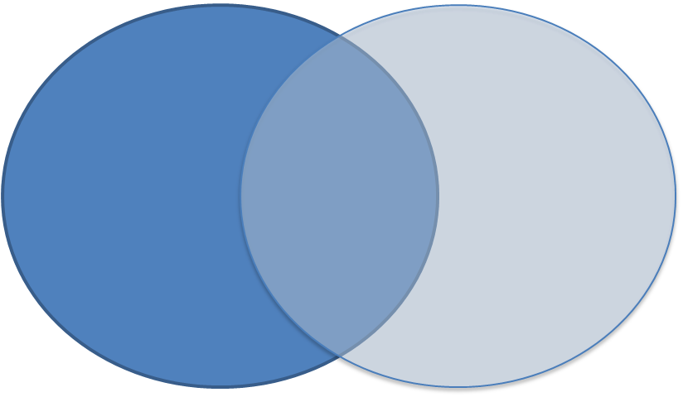
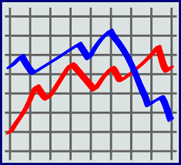
CATEGORIES OF DATA
Using separate post-it notes, write down types of assessments you use.
Qualitative
Data expressed in words.
Quantitative
Data expressed in numbers.
Now separate into qualitative and quantitative
Notes:
Participants will have an opportunity to identify all the types of assessments used in an instructional setting.
Provide brief review of the difference between qualitative and quantitative data with examples.
Qualitative: Data expressed in words; collected by interviews, observations, document analysis, or open-ended questions on surveys.
Quantitative: Data expressed in numbers and analyzed statistically; collected from frequency counts, surveys, or test scores.
Participants will be given 1 minute to write down types of assessments used throughout their practice.
Participants will then be assigned the task of separating the types of assessments into Qualitative and Quantitative on the Venn Diagram seeing that some assessment types depending on their use will overlap into both areas.
Participants jot down what the purposes of the assessments are.

Slide 13
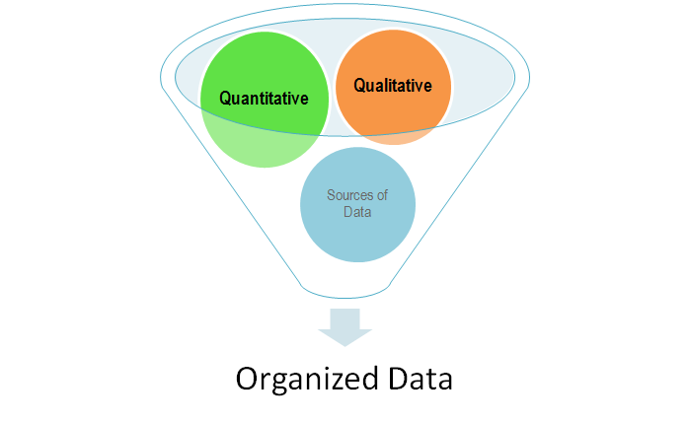
DATA OVERLOAD
Benchmarks
Quizzes
Observations
PARCC
DRA
Notes:
Share with participants that now that multiple types of assessments have identified, this can inevitably lead to a data overload. This module will assist you in filtering the data so that it can be utilized effectively through the use of specific protocols.
Draw participant’s attention to the fact that with all of these assessment types there can be a Data Overload.
Now let's prioritize the data (post its) at your table - Group needs to organize the post it notes from the slide 17 activity and choose top valued.
Adaption - Have participants choose top two or three valued assessments.
Activity purpose: Make the statement - All data has merit in the classroom, depending on your instructional placement.
Presenter notes: Overall goal is to meet your specific learners at their instructional level to make improvements.

Slide 14
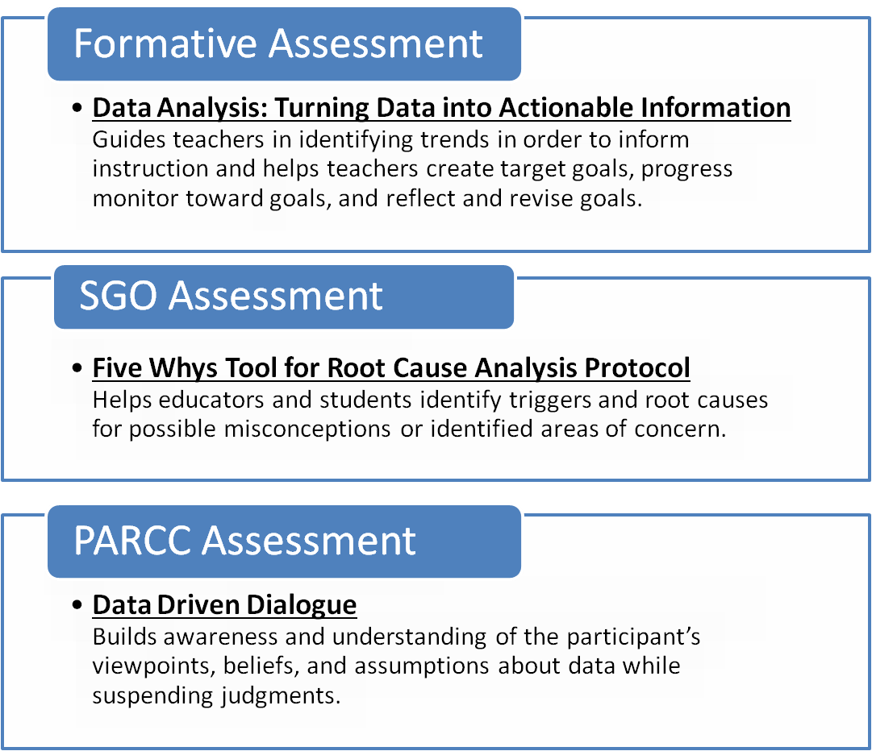
PROTOCOLS
Protocols are procedures that help teams function better and meet their goals. The protocols that will be utilized in data analysis provide structure through which effective communication is promoted and team structure is built via content-focused collaboration.
http://www.state.nj.us/education/AchieveNJ/teams/Toolkit.pdf
Notes:
There is animation on this slide: Click for the working definition on Protocols to come up and click again to show the types of protocols we will be using.
Working definition is from http://www.state.nj.us/education/AchieveNJ/teams/Toolkit.pdf
Discuss the importance of protocol and why they are productive. Discuss the importance of collaboration in analyzing data. Remind participants that there are many protocol to choose from. Three will be presented in this module.
Additional protocol can be found here: http://www.schoolreforminitiative.org/protocol-alphabetical-list-2/

Slide 15
AGENDA
INTRODUCING CORE CONCEPTS
USING DATA TO DRIVE INSTRUCTION –FORMATIVE ASSESSMENT DATA
CLOSING THOUGHTS

Slide 16
MONITORING CYCLES
A process by which teachers…
Plan – Develop curriculum, instruction, and assessments
Implement – Teach or take plan into action
Collect – Gather indicators of student progress or other evidence of practice
Analyze – Identify trends, patterns, and student misconceptions; decide what needs more reinforcement or re-teaching
Plan – Reflect on and revise the plan based on analysis of the data
Plan
Implement
Analyze
Collect
Notes:
Where does Formative assessment fit into the monitoring cycle?
Give participants a moment to think about this and share out (either small group or whole group).
Guidance:
Formative Assessment is embedded within the entire process. As the teacher is implementing instruction, the teacher is gaining formative assessment data, while monitoring student understanding and simultaneously collecting data. The data is then analyzed for the purpose of adjusting instruction. Then the cycle continues again.

Slide 17
FORMATIVE ASSESSMENT DATA
Formative assessments monitor student learning and adjust ongoing instruction.
Quizzes and exit tickets
Checks for understanding (including digital platforms)
Running records
Reflective journals
Behavior/classroom management systems
Teachers can utilize the data to adjust instruction and accelerate learning. Collaboratively analyzing formative assessment data addresses the question, “How can we collectively ensure that all of our students can meet the objectives?” The formative data should be used to drive instruction, not to evaluate educators.
Students can use this information to help self-regulate their learning.
Notes:
Mention the connection to the Assessment module here
Options for Discussion:
Have participants share additional examples of formative assessments.
Allow participants to briefly discuss how a few of these relate to the definition and purpose (e.g. how to use running records to monitor student learning and adjust instruction).
“Collaboratively analyzing formative assessment data addresses the question, ‘How can we collectively ensure that all of our students meet the objectives?’ The formative data should be used to drive instruction, not to evaluate educators.” -- This was pulled from The NJDOE Blended Online Learning Module, Course 3. For a deeper dive, participants can visit: http://www.online-plc.org/mod/page/view.php?id=303

Slide 18
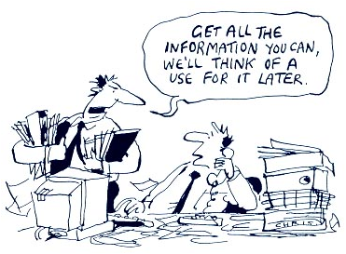
ANALYZING FORMATIVE ASSESSMENT DATA
“What gets measured gets done.”
Notes:
Transition slide to move into the Data Analysis Protocol
So let’s tie this all together. We collect all this data, we don’t want this to go to waste
Kumar, Vishal.”On Big Data”
Presenter Notes: Now that you have sorted your data, we are going to put it into use through the Data Analysis Protocol.

Slide 19
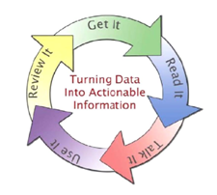
PROTOCOL INSTRUCTION
Get It!
Select the data to analyze for future action. (e.g., exit tickets, benchmark tests, quizzes, etc.)
2. Read It!
Answer the following questions as it applies to your data.
What pops out at you?
Why is this data important?
If this data remains constant, what might be the possible consequences for our students?
What are your hunches about what might need to happen next to impact this data?
Turning Data into Actionable Information Protocol
Notes:
Adapted from Western Heights Independent School District, PLC Data Analysis Template ©2008
Participants will begin by using a provided Data Sample Set to apply to the current protocol. Participants will apply this same protocol to their own data at the conclusion of the activity, providing an opportunity to reflect.
This is in preparation for the Talk Iit

Slide 20
PROTOCOL INSTRUCTION
3. Talk It!
Select a discussion leader who will facilitate an active dialogue.
What are the data facts that popped out during Read It! phase?
Why is this data important?
What are some possible actions that can be taken to address the data implications?
Fill out the following columns:
Here’s What! Specific Facts | So What? Interpretation of Data | Now What? Prediction / Implications of Data
Notes:
While groups begin Talk It! Phase, each group will have an assigned “Active Listener Recorder” who will fill in the three columns - Here’ What! So What! And Now What! as team members discuss observed trends and come to decisions.
Participants will be directed to continue to follow the presented protocol. Referenced in their binders.
Use It and Review It
In your groups, decide what the data is saying. The Here’s What! column is filled with specific facts (Ex: 30% of Grade 5 students did X?; the So What? Column is an interpretation of the data; and the Now What? Column can be a prediction, an implication or a question for further study. HERE’S WHAT! SO WHAT? NOW WHAT? Chart taken from “Data Driven Dialogue: A Facilitator’s Guide to Collaborative Inquiry”, Bruce Wellman & Laura Lipton
Apply It
What action steps or strategies will you take to achieve the goal?
Who is going to be responsible for implementing the strategies?
When will you monitor your progress toward meeting the goal?
What materials, resources, and/or personnel will be necessary to carry out the strategy?
What data will you use to monitor and review your progress in meeting your goal?

Slide 21
DATA ANALYSIS PROTOCOL
PROTOCOL INSTRUCTION
4. Use It!
What is your target or goal?
What data will you use to monitor and review your progress in meeting your goal?
Apply to the presented chart:
5. Review It!
Monitor your timeline.
Then, review how the current data compares to what you expected. You may need to reassess your goal or action plan.
Notes:
At the conclusion of application of the Data Analysis Protocol
Have each group share out their Actionable Step.
Have the presenter make comments about the observations made throughout the protocol instruction.

Slide 22
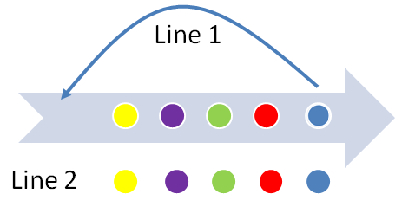
NEXT STEPS
Inner/Outer Circle or Moving Down the Line Activity
How can you use the results from this formative data protocol to drive your instruction?
Identify which team members you can utilize this protocol with in your school building.
How are you going to use this protocol when you return to your classroom to examine student achievement?
Notes:
A note to future presenters: Should you have an issue with space, time, or audience size, this slide can be amended to a Turn and Talk. “Turn to the person next to you and answer the following:” The presenter will have to provide the question, allow time for discussion, then provide the next question and continue this process until the three questions have been answered.
Inner/Outer Circle or Moving Down the Line Activity
How can you use the results from this formative data protocol to drive your instruction?
Identify which team members you can utilize this protocol with in your school building.
How are you going to use this protocol when you return to your classroom to examine student achievement?
When activity is complete and participants return to their seats, SHARE OUT as a whole group.

Slide 23
AGENDA
INTRODUCING CORE CONCEPTS
USING DATA TO DRIVE INSTRUCTION –SGO ASSESSMENT DATA
CLOSING THOUGHTS

Slide 24
MONITORING CYCLES
A process by which teachers…
Plan – Develop curriculum, instruction, and assessments
Implement – Teach or take plan into action
Collect – Gather indicators of student progress or other evidence of practice
Analyze – Identify trends, patterns, and student misconceptions; decide what needs more reinforcement or re-teaching
Plan – Reflect on and revise the plan based on analysis of the data
Plan
Implement
Analyze
Collect
Notes:
Where does SGO data fit?
Plan: Teachers plan for the academic year so that their students will be able to learn all the required standards. They plan what each instructional unit will look like as well as those for the week and each day. In addition, they plan what types of assessments they should give and when they should give them. The plans that teachers develop are informed by what they have learned from their work in previous years as well as what happened that day in class.
Implement the Plan: In the teacher’s world, implementation is teaching. Teachers follow their short and long-term plans throughout the year, adjusting as needed based on their students’ needs.
Collect Data: To evaluate how their students are progressing, teachers assess their students continually. They collect information from question and answer sessions, during cooperative group work, through exit tickets, in analyzing homework, on unit tests and quizzes, and in many other ways. These forms of assessment all provide evidence that lets a teacher know whether her plans are resulting in the desired outcomes for her students.
Analyze Data: Teachers analyze the data they collect from their students to find patterns that can help inform and improve their instruction and various supports they provide their students. When appropriate, this analysis may lead to changes in the plan of how and what the teacher teaches, completing the cycle. This data leads to a refining of the plan moving forward.

Slide 25
SGO ASSESSMENT DATA

Slide 26
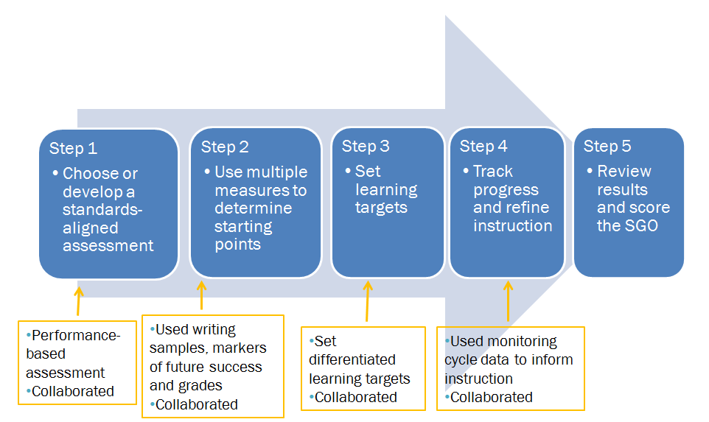
SGO PROCESS
Now that we have collected data from a standards-aligned assessment, what is next?
Dive into your data to identify starting points, or a root cause.
Notes:
These are the 5 steps of the SGO process. Along the way, your SMART Goal may have to be adjusted

Slide 27
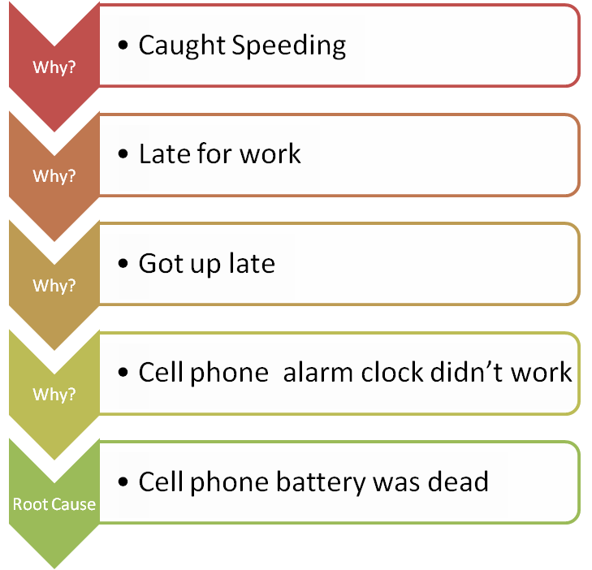
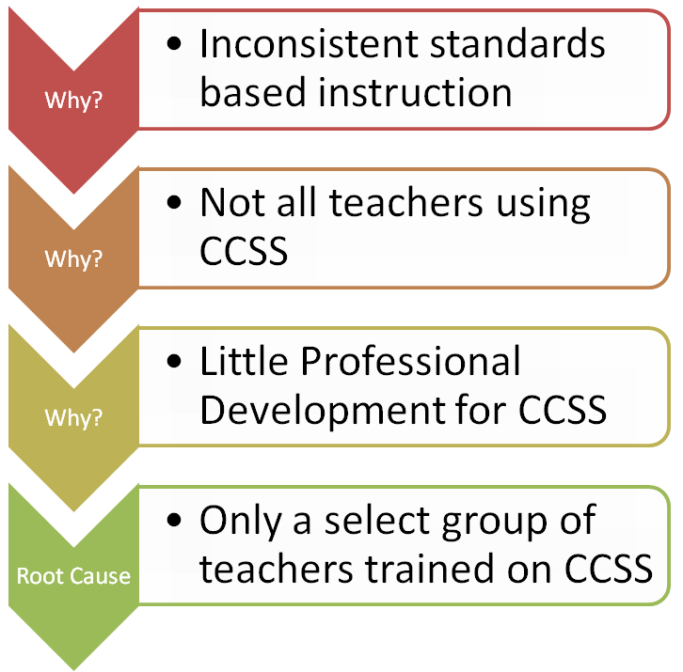
UNDERSTANDING ROOT CAUSE ANALYSIS
By repeatedly asking the question, “Why?”, you can peel away the layers of an issue and get to the root cause of a problem.
Problem Statement: Significant amount of students were not proficient schoolwide on a standards-aligned assessment.
A Root Cause is “the most basic reason the problem occurs.”
(Definition from “Total Quality Schools,” by Joseph C. Fields)
Problem Statement: I missed 1st period PLC.
Keep asking “Why?” until you get to an actionable level.
Notes:
Taking practice of everyday life and relating to our practice.

Slide 28
PROTOCOL INSTRUCTION
5 Whys for Root Cause Analysis
Purpose: To help the educators get to the root cause of a problem.
Protocol found in the Collaborative Teams Toolkit.
Steps | Description
Identify area of focus for student growth | After reviewing data, teacher describes the potential area of focus. Questions to consider: · Why you chose this question? · Why it is so important to you? · How it relates to your class? Group asks questions to clarify the context.
Steps | Description
2. Brainstorming | The team facilitator asks why the problem happened and records the team response. To determine if the response is the root cause of the problem, the facilitator asks the team to consider "If the most recent response were corrected, is it likely the problem would recur?" If the answer is yes, it is likely this is a contributing factor, not a root cause.
Steps | Description
3. Why Questioning | If the answer provided is a contributing factor to the problem, the team keeps asking “Why?” until there is agreement from the team that the root cause has been identified. It often takes three to five whys, but it can take more than five! So keep going until the team agrees the root cause has been identified.
Let’s dig down to the roots!
28
Notes:
Inform participants the steps and protocol are taken from the Collaborative Teams Toolkit (SRI).
What is the 5 whys for Root Cause Analysis?
The Five Whys is a simple problem-solving technique that helps to get to the root of a problem quickly.
The Five Whys strategy involves looking at any problem and drilling down by asking: "Why?" or "What caused this problem?"
While you want clear and concise answers, you want to avoid answers that are too simple and overlook important details.
Typically, the answer to the first "why" should prompt another "why" and the answer to the second "why" will prompt another and so on; hence the name Five Whys. This technique can help you to quickly determine the root cause of a problem. It's simple, and easy to learn and apply.
During this process the presenter should address that an identified problem maybe be a student misconception. The critical component in this process is drilling down to find the roots cause.
Use brief example on Protocol: Your car gets a flat tire. Use laminated large Protocol worksheet as model.
The process may be repeated for multiple identified problems.

Slide 29
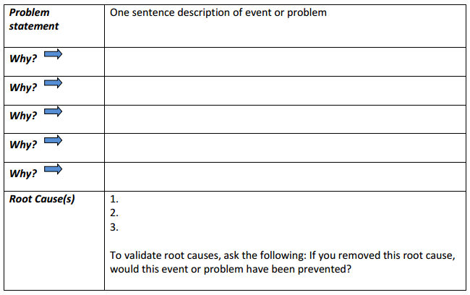
PROTOCOL ACTIVITY
Step 1: Review Data
Identify area of focus for student growth | Look at your data. What trends do you see?
Step 2: Brainstorming
Step 3: WHY Questioning: May take up to 5 Whys until the root cause is identified.
29
Notes:
http://www.nj.gov/education/AchieveNJ/teams/strat21/FiveWhysforRootCauseAnalysis.pdf
Facilitator distributes Protocol worksheets.
Teams use work time to examine data, develop one problem statement, and work through the five whys protocol.
Note (possibly to include in survey before presenting): All Districts should be bringing the same type of SGO data for this conversation to be relevant. Survey Question: What type of SGO data will you be bringing?

Slide 30
SGO PROCESS
Set learning targets.
Consider creating
SMART GOALS.
Notes:
So now that you have identified a root cause in step 2, let’s dive into step 3, setting some learning targets. Participants should consider a method to set learning targets is to use the SMART goal process

Slide 31
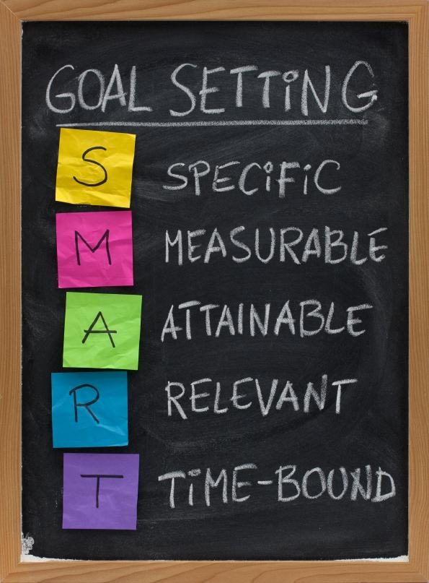
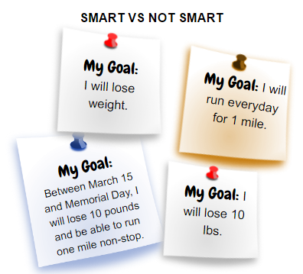
WHAT IS A SMART GOAL?
Notes:
Examples to get participants thinking about the rigor of created SMART Goals.

Slide 32
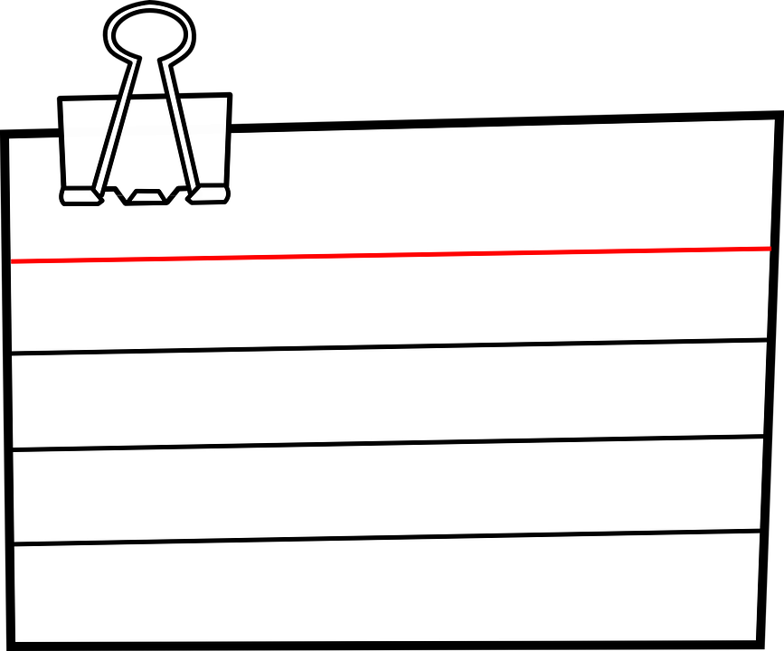
SET A SMART GOAL
At least ___% of my _______ students will score at or above ____% on the________________ by ___________.
SMART Goal Sentence Frame
Activity: Create a Smart GOAL with your group using the sentence frame provided.
Notes:
Teacher Activity: Using the SMART Goal Sentence Frame, create a SMART GOAL related from the root cause discussed earlier. On a BIG sticky note: Using the data we identified the root cause, create a SMART goal with your group using the sentence frame provided. Be sure to check your SGO using the SMART goal format on the chart to be sure you covered all of the components. Collect sticky notes to display.

Slide 33
SMART GOALS SMART SGOs
Notes:
Explanation: This slide was created by the state and is aligned to the SMART goal development. Tell teachers we will use the SMART goal framework for creating SGOs. Point out how SMART Goals are AMBITIOUS

Slide 34
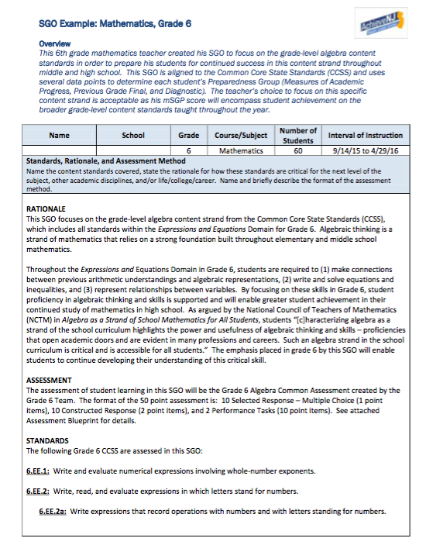
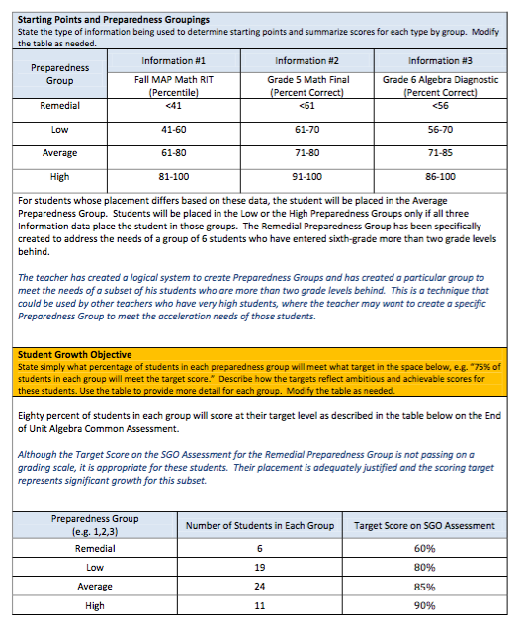
HOW SMART IS YOUR SGO?
Step 2:
Determining ⬅Starting
Point
Step 3:
Setting
⬅Learning
Targets
Step 1: Standards Aligned ➔

Slide 35
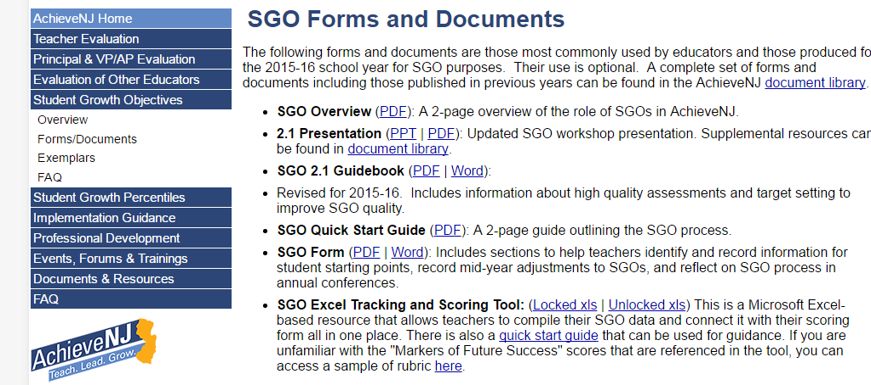
NEXT STEPS
Be on the lookout for additional supports:
SGO Quality Rating Rubric
Updated SGO Excel Tracking and Scoring Tool

Slide 36
AGENDA
INTRODUCING CORE CONCEPTS
USING DATA TO DRIVE INSTRUCTION –PARCC ASSESSMENT DATA
CLOSING THOUGHTS
Notes:
As we enter into the PARCC portion, we know that your teams are representative of a range of grade levels and disciplines within your organization. By owning PARCC data, we recognize that everyone plays a role in helping students master the standards throughout their learning careers.

Slide 37
MONITORING CYCLES
A process by which teachers…
Plan – Develop curriculum, instruction, and assessments
Implement – Teach or take plan into action
Collect – Gather indicators of student progress or other evidence of practice
Analyze – Identify trends, patterns, and student misconceptions; decide what needs more reinforcement or re-teaching
Plan – Reflect on/ revise the plan based on analysis of the data
Plan
Implement
Analyze
Collect
Notes:
Where does PARCC data fit?
Starts in the “collect” part of the cycle. Then, threads throughout the rest of the cycle.
Threads by: curriculum, instruction, assessments reflection and implementation

Slide 38
PARCC
How will PARCC results help you as a teacher?
Group discussion: As a group, reflect upon the following statement and discuss how it lends itself to the role PARCC plays in your district and your own teacher practice.
Regardless of your grade level, discipline, or instructional placement the PARCC assessment can play a key role in maximizing student achievement.
Notes:
Video hyperlink-https://www.youtube.com/v/jIJKSKuGUhw
If concerns come up: Let’s remember that all data are good data. PARCC is aligned to standards. While it is a different way to assess our students, it is closely tied to the standards which is what the teaching and learning goals are. In your Assessment module, you’ll understand, if you haven’t already, that standards drive assessments.
Teachers can reflect on what PARCC really means to them, the true purpose of PARCC and it’s true intentions to drive instruction.
*Reference from PARCC needs to be inputted
Regardless of your grade level, discipline, or instructional placement the PARCC assessment can play a key role in maximizing student achievement.

Slide 39
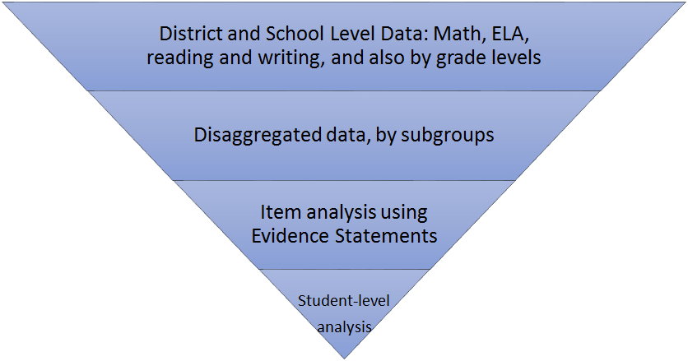
PARCC ASSESSMENT DATA
39
Notes:
This shows the different levels that data can be evaluated. Briefly explain each level, then focus on the teacher role of data analysis. Looking for trends, in own data and what can we do with this data to drive instruction.

Slide 40
MATERIALS NEEDED TO DO THIS WORK
Evidence Based Tables Published by PARCC
Literacy Evidence Tables
(Reading and Writing)
Math Evidence Tables
Partnership Resource Center
Create an Account - It’s Free!
NJ Code: nj1787
PARCC Released Items
Notes:
This is the data teachers come with. If not, have spare data to use or participants can work with a partner.

Slide 41
PROTOCOL INSTRUCTION
Data Driven Dialogue
http://schoolreforminitiative.org/doc/data_driven_dialogue.pdf
Phase I: Predictions - Surfacing perspectives, beliefs, assumptions, predictions, possibilities, questions, and expectations
Phase II: Go Visual - Re-create the data visually
Phase III: Observations - Analyzing the data for patterns, trends, surprises, and new questions that “jump” out
Phase IV: Inferences - Generating hypotheses, inferring, explaining, and drawing conclusions; defining new actions and interactions and the data needed to guide their implementation; building ownership for decisions
Notes:
Introduce each step.
Instruct participants on how to use the protocol in a collaborative setting. Be sure to address student misconceptions.
Works Cited: School Reform Initiative

Slide 42
PROTOCOL ACTIVITY PHASE 1 PREDICTIONS
Look at Evidence Tables to formulate predictions before reviewing data
Please reflect privately and record several of your preliminary thoughts about the data. One or more of the following thought-starters may be helpful.
I assume…
I predict…
I wonder…
My questions/expectations are influenced by…
Some possibilities for learning that this data may present…
Notes:
Pass out evidence tables available for ELA and Mathematics across grade levels
a. Group fills out predictions sheet b. Round-robin report-out of predictions (one item each person, one round only) May be charted by the facilitator or other member of the group

Slide 43
PROTOCOL ACTIVITY
PHASE 2 GO VISUAL
Re-create the data visually, on large sheets of paper, on a data wall, etc.
Mark up the data to better understand it (i.e., highlight trend lines in different colors, do math calculations and chart those, color code parts of the data that relate to each other).
Make the data your own!
Notes:
Note: If participants feel more comfortable utilizing Google or Excel they can be encouraged to do so.
Facilitator will Fish Bowl this step of the protocol
Participant work
During Phase II Go Visual you re-create the data visually, on large sheets of paper, on a data wall, etc.
Participants mark up the data so they better understand it (i.e., highlight trend lines in different colors, do math calculations and chart those, color code parts of the data that relate to each other).
Participants might create visuals individually or in pairs or triads. Depending upon the amount of data, it might be helpful to divide it into subsets and identify who in the group will work with different subsets.
Create visuals individually or in pairs or triads. Depending upon the amount of data, it might be helpful to divide it into subsets and identify who in the group will work with different subsets.
Works Cited:
http://www.state.nj.us/education/assessment/parcc/resources/evidence.pdf

Slide 44
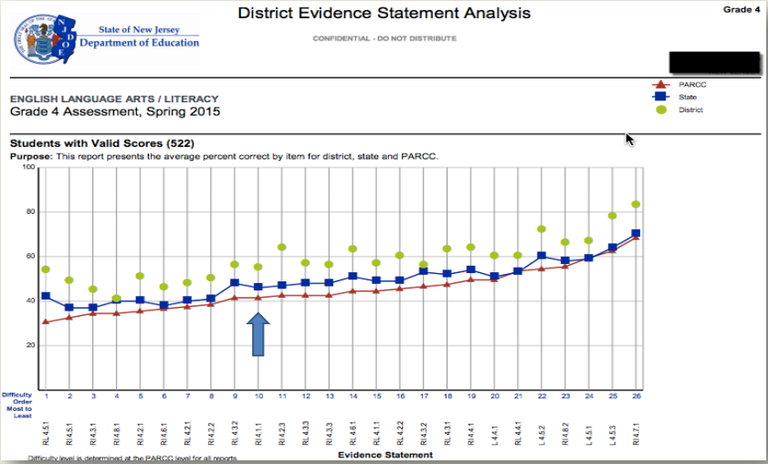
PROTOCOL ACTIVITY
PHASE 2 GO VISUAL
Notes:
Facilitator will FishBowl on this slide (which is posted to go with slide 49 for the same step) to model a conversation starter for this step of the protocol and then turn over discussion to attendees.
During Phase II Go Visual you re-create the data visually, on large sheets of paper, on a data wall, etc.
Participants mark up the data so they better understand it (i.e., highlight trend lines in different colors, do math calculations and chart those, color code parts of the data that relate to each other).
Participants might create visuals individually or in pairs or triads. Depending upon the amount of data, it might be helpful to divide it into subsets and identify who in the group will work with different subsets.
Works Cited:
http://www.state.nj.us/education/assessment/parcc/resources/evidence.pdf

Slide 45
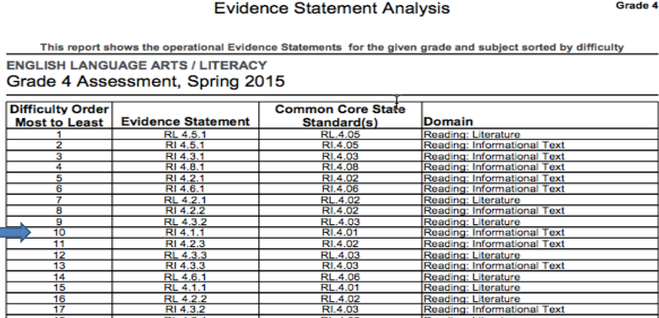
EVIDENCE STATEMENT ANALYSIS
Notes:
When engaging in the protocol, you will be taking a close look at the evidence statement analysis report, the evidence table, and the PARCC released items.

Slide 46
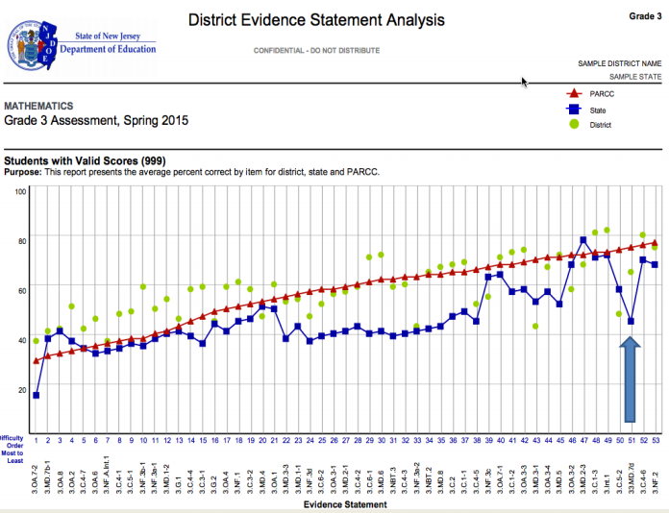
PROTOCOL ACTIVITY
PHASE 2 GO VISUAL
Notes:
Slides 54 and 55-Option 2 slide for Math Data instead of ELA

Slide 47
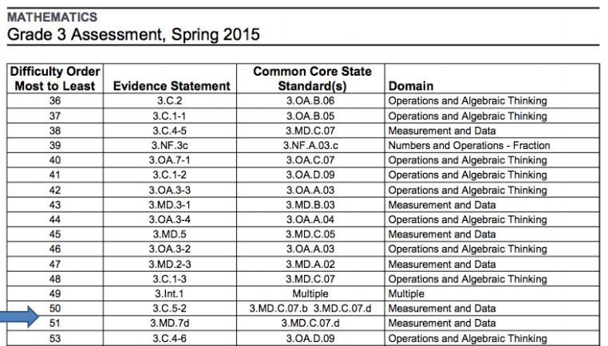
EVIDENCE STATEMENT ANALYSIS REPORT

Slide 48
PROTOCOL ACTIVITY
PHASE 3 OBSERVATIONS
Engage with the actual data and note only the facts that you can observe in the data
Please study the data privately and record several of your observations.
Notes:
Facilitator kicks off group work. Participants engage in the work.
During Phase III Observations dialogue, you engage with the actual data and note only the facts that you can observe in the data. Conjectures, explanations, conclusions, and inferences are off-limits. You make statements about quantities (e.g., Over half the students…), the presence of certain specific information and/or numerical relationships between ideas (e.g., Over 90% of the students achieved below standard in Problem Solving; Compared to last year’s data, the percentage of students performing at the advanced and on-standard levels in Skills increased by 8%…).

Slide 49
PROTOCOL ACTIVITY
PHASE 4 INFERENCES
During Phase IV Inferences dialogue, you…
generate multiple explanations for your Phase III Observations.
identify additional data that may be needed to confirm/contradict your explanations.
propose solutions/responses.
identify data needed to monitor implementation of your solutions/responses.
Explanations
Solutions
Confirmation
Implementation
Notes:
Private Think Time Before beginning Phase IV Inferences dialogue with your colleagues, please reflect privately, using one or more of the following thought starters to prompt your thinking: • I believe the data suggests… because… • Additional data that would help me verify/confirm my explanations is… • I think the following are appropriate solutions/responses that address the needs implied in the data… • Additional data that would help guide implementation of the solutions/responses and determine if they are working…

Slide 50
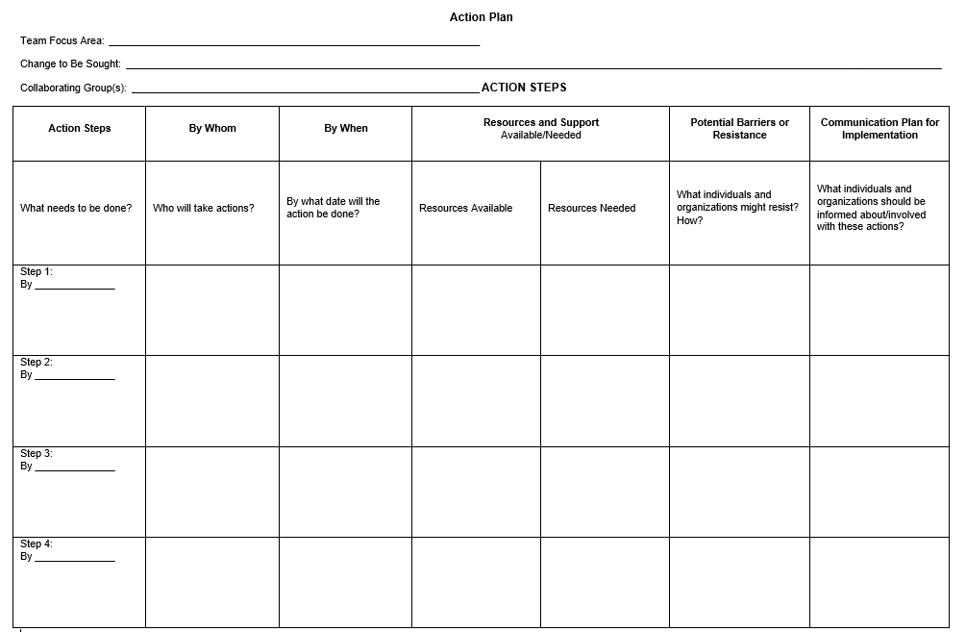
NEXT STEPS
Notes:
How do you use this for the students you have now? How does this impact what you do next year? What do you do with it? What is the practical use of the analysis? To adjust instruction and curriculum? Be explicit and concrete.
This is an action plan for designed for teachers to use to have concrete steps to take after the training that will impact teaching and learning. What is your goal for the delivery of instruction and curriculum after gaining insight into the assessment results? Turn and talk
(The steps are based on either continuing the protocol on PARCC data or if it was completed, moving to instructional changes and curricular changes. The steps with inevitably depend on who is attending and the influence they have. Teachers can have control over instruction and delivery but may not be able to control curriculum. However, everyone can look at the protocol findings and plan next steps to impact instruction and learning.)
Thinking about your curriculum and your teaching practice/delivery, and thinking about your student population, what is the first step that you can take being armed with the information you gained from the protocol and/or the process that you will implement when you return to your school?

Slide 51
AGENDA
INTRODUCING CORE CONCEPTS
USING DATA TO DRIVE INSTRUCTION
CLOSING THOUGHTS
Notes:
This is time to wrap it up

Slide 52
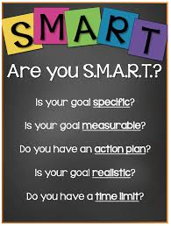
MOVING FORWARD
Plan
Implement
Collaborative Teams
Data Audits
SMART Goals
Analyze
Collect
Notes:
Now that we have engaged in several protocols for different types of data, what can we do moving forward?
We have already participated in some form of data audits, now you will be taking this work back to your own teams within your district, as well as, presenting to other districts.
*we have looked at data
*we know to work in collaborative teams to audit our data
*then, set SMART goals to go back and continue this work in own and out of districts

Slide 53
COLLABORATIVE TEAMS
Collaborative teams provide educators opportunities to have evidence based conversations.
Depending on the nature and length of the monitoring cycle, different types of collaborative teams may be appropriate.
1 on 1 meetings
Large Groups
Small Teams (3-5 people)
Notes:
Generate answers about current partnerships in from audience: Who do you currently collaborate with? Then: What are additional collaborations you can benefit from? (watch timing, keep to minimum)
If time permits-Can use post-it and a T-Chart at the tables.
I&RS, grade level meetings, PLCs, Post Obs, CST, Guidance, Various committees, 1-on-1 in hallways w/ colleagues
As you present to other participants, you might notice that some educators are resistant to the concept of PLCs or function as passive participants in PLCs. This link would be a great resource to help teachers better understand how valuable PLCs can be in terms of impacting daily instruction. Course 1: http://www.online-plc.org/mod/page/view.php?id=1079 This link is from the NJDOE Blended Online Learning Modules site. This resource is free to anyone who has an email address of any kind.

Slide 54
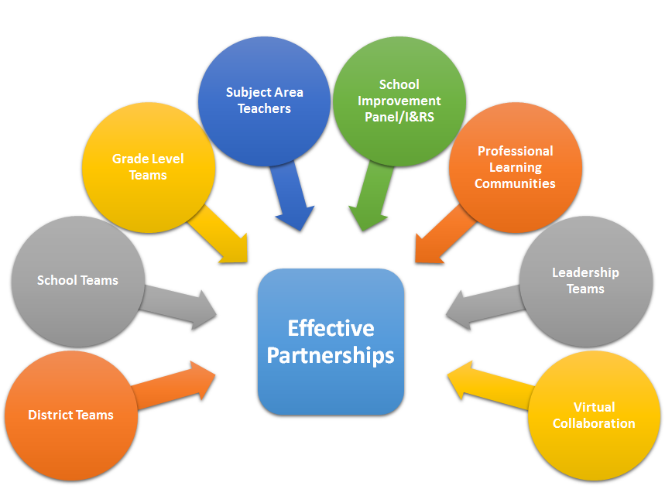
EFFECTIVE PARTNERSHIPS
Notes:
To help participants better understand collaborative teams, this visual shows common examples of effective partnerships in education.
Data Audit Resource available to schools and district level collaborators.
Our data collection is the small piece to the larger puzzle in our district. Collaborative teams that involve teachers, school, and district leaders can engage in a data audit, which is a process that helps school leaders backwards-plan from available data sources to specific instructional purposes and needs for their schools, making the most effective use of student data for a wide variety of purposes. This resource is available to be used to continue the long term process in your District. http://www.state.nj.us/education/AchieveNJ/teams/Toolkit.pdf

Slide 55
SETTING A SMART GOAL
Our SMART Goal is...
Notes:
Now that we have looked at different types of data and protocols, it is time to set a goal, a smart goal.
Explain what a smart goal consists of - briefly - as this is a repeated exposure to smart goals

Slide 56
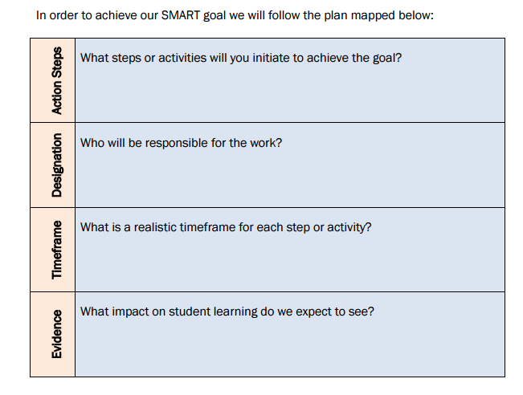
TEAM SMART GOAL SETTING PLAN
Think about...
DATA
TRENDS
NEXT STEPS
REFLECT/REVISE
Notes:
Now we are going to ask you to work within your teams: complete, as a team, each of the 4 questions above. Make an actual smart goal to help you, as a team, determine what you plan to do with the protocols you’ve learned thus far. This will prepare you for the reflection piece coming up.
What is our team’s current reality – what are our areas of strength, areas of weakness and potential areas for focused attention? Based on our current reality, we believe that the following area of focus for our work will impact student learning: We have collectively developed the following SMART (specific, measurable, achievable, results-oriented and timely) goals to address this area of focus:
NJDOE Collaborative Teams Toolkit, Sample SMART Goal Setting Plan

Slide 57
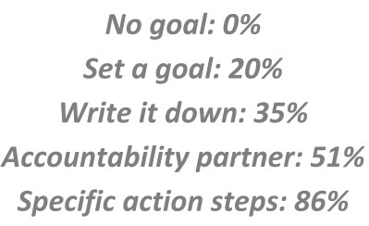
WRITE A SMART GOAL THAT “STICKS”
Now that you have a goal, let’s make it stick!
Want to meet up at the gym?
Sure!
Nov. 5
Gym Today
6:30PM
Picking you up at 6:30!
Notes:
Relate these images to the goal setting percentages:
No Goal: 0%
Set a goal: 20%
Write it Down on your calendar: 35%
Accountability Partner: 51%
Specific Action Steps: 86%
Have Participants write a SMART Goal

Slide 58
MODULE REFLECTION
Gallery Walk
Create data-driven SMART goals from the following partnership choices on post-it notes
Post created goals on the Effective Partnership chart paper
Review created goals by teams, making comments on presented chart paper
OUR Goal
Notes:
Individual reflection work:
Prepare materials ahead of time. Have enough Post-Its handy for all participants so that they may jot down comments/feedback. Have chart paper labeled for each of the listed “Effective Partnerships” (8 headings).
Do:
discuss that this is a time for individual (or as groups) reflection based on the effective partnerships and SMART goals that you are making
each participant will jot SMART goals with partnerships in mind
then, add to matching chart paper located around the room
after goals are set and posted, complete a gallery walk and add your thinking to the chart, now responding to others or add additional reflections the gallery walks prompted
Finally, share-out new thinking and talk about how these are real take-aways to start this work back in own districts

Slide 59
ADDITIONAL RESOURCES
Collaborative TeamsToolkit Blended Online Learning Modules NJ CORE PARCC PRC
Notes:
The Collaborative Teams Toolkit is intended to help schools establish productive collaborative teams of teachers and administrators working and learning together to help their students. This toolkit focuses on supporting the monitoring of Student Growth Objectives (SGOs) and other student data by providing the necessary tools to promote the environment for having successful evidence-based conversations. This toolkit is built following New Jersey's Standards for Professional Learning.
Blended Online Learning Modules-The New Jersey Department of Education (NJDOE) has collaborated with educational professionals, school leaders and other stakeholders to create this dynamic suite of online learning resources to support the professional development of New Jersey educators. The focus of the modules is using the Connected Action Roadmap Framework to guide PLCs.
NJCORE-The New Jersey Collaborative Online Resource Exchange was developed to meet the needs of educators and community members who want to locate standards-aligned resources. This site is by educators and for educators. Contribute your learning resources, access existing resources, and collaborate with other New Jersey educators.
SGO Workshops-The Evaluation Team provides workshops, trainings, and other direct support to educators across the state.
Partnership Resource Center-Our community of educators, parents, and others committed to quality assessment leading to student success invite you to register, browse, learn, and implement to enhance your knowledge of assessments within the classroom.

